Slide 1
Ezekiel

Slide 2
Ezekiel
Who was Ezekiel?
Priest in exile
Where did he preach?
In Babylon
“Transported” to Jerusalem
When did he preach?
593-571

Slide 3
Structure
Ezekiel 1-24--Judgment
- 1:1-3:21—Ezekiel’s Call as Prophet
- 3:22-5:17—Signs of Judgment
- 6-7—Oracles of Judgment
- 8-11—Visions of Judgment
- 12-24—Signs/Oracles of Judgment
Foreign Prophecies
Ezekiel 33-48--Restoration
- 33-39—Restoration of Israel
- 40-48—A New Temple & A New Land

Slide 4
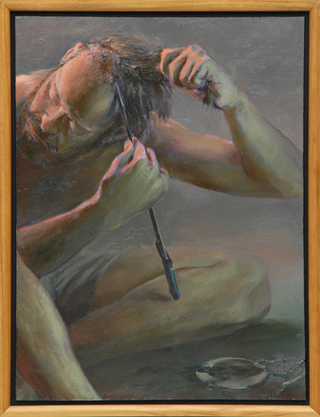
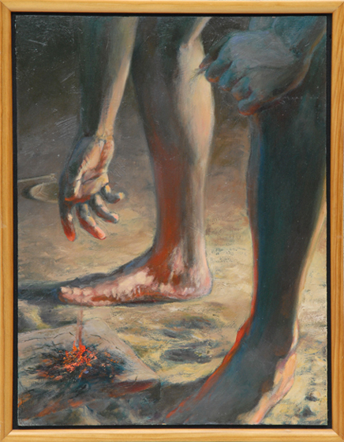
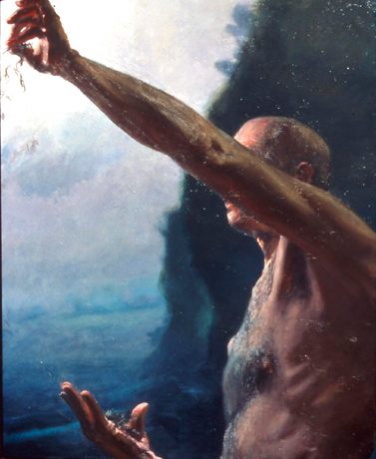
Message of Ezekiel
Signs of Judgment
Ezekiel 5

Slide 5
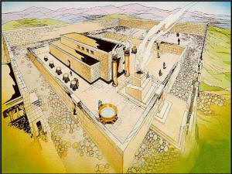
Message of Ezekiel
The Glory Departs the Temple (Ez. 8-11)
Ezekiel 8:1-6, 12-15
Ezekiel 9:3-6
Ezekiel 10:18-19
Ezekiel 11:22-24

Slide 6
Message of Ezekiel
Words of Restoration
Ezekiel 36:24-27

Slide 7
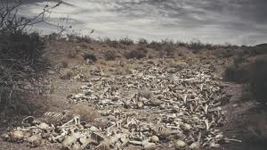
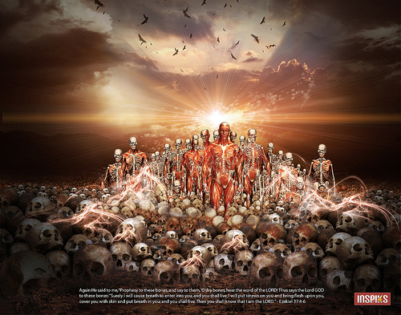
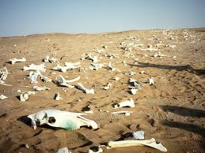
Message of Ezekiel
Words of Restoration
Ezekiel 37:1-14

Slide 8
Message of Ezekiel
Message?
They are God’s chosen and He will give them new life!

