Slide 1
Prophets III
Joel, Jonah, Isaiah 40-66
Haggai, Zechariah, Malachi

Slide 2
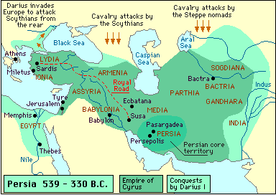
Prophets and History
Exile and the Post-exilic Period

Slide 3
Isaiah: 1, 2, or 3?
 | Isaiah 1-39 | Is. 40-55 | Is. 56-66
Audience | 8th century | Exile | Judah
Themes | Judgment Remnant Messiah Trust | Comfort Deliverance Redemption | Repent Idolatry Sabbath
Historical References | Isaiah, Uzziah, Ahaz, Hezek., Sennacherib, Isaiah’s sons | Cyrus | None

Slide 4
The Message of Isaiah 40-55
God of Comfort and Hope
⁸ The grass withers, the flower fades, but the word of our God will stand forever.⁹ Get you up to a high mountain, O Zion, herald of good news; lift up your voice with strength, O Jerusalem, herald of good news; lift it up, fear not; say to the cities of Judah, “Behold your God!” (40:8-9 ESV)

Slide 5
The Message of Isaiah 40-55
Why do you say, O Jacob, and speak, O Israel, "My way is hidden from the LORD, and my right is disregarded by my God”? Have you not known? Have you not heard? The LORD is the everlasting God, the Creator of the ends of the earth. He does not faint or grow weary; his understanding is unsearchable. He gives power to the faint, and to him who has no might he increases strength. ³⁰ Even youths shall faint and be weary, and young men shall fall exhausted; but they who wait for the LORD shall renew their strength; they shall mount up with wings like eagles; they shall run and not be weary; they shall walk and not faint. (40:27-31 ESV)

Slide 6
The Message of Isaiah 40-55
God as Redeemer (49:7)
⁷ Thus says the LORD, the Redeemer of Israel and his Holy One, to one deeply despised, abhorred by the nation, the servant of rulers: “Kings shall see and arise; princes, and they shall prostrate themselves; because of the LORD, who is faithful, the Holy One of Israel, who has chosen you.” (Isa 49:7 ESV)

Slide 7
The Message of Isaiah 40-55
God’s Suffering Servant (53:5-6)
But he was pierced for our transgressions,
he was crushed for our iniquities;
the punishment that brought us peace was upon him,
and by his wounds we are healed.
We all, like sheep, have gone astray,
each of us has turned to his own way;
and the LORD has laid on him the iniquity of us all (ESV).

Slide 8
The Message of Isaiah
“The Servant of the LORD”
42:1-4
49:1-6
52:13-53:12
Messiah
Remnant
Nation
From Lasor, Hubbard, Bush

Slide 9
The Message of Isaiah 40-55
Come and drink (55:1-3)
“Come, all you who are thirsty, come to the waters; and you who have no money, come, buy and eat!
Come, buy wine and milk without money and without cost.
Why spend money on what is not bread,
and your labor on what does not satisfy?
Listen, listen to me, and eat what is good,
and your soul will delight in the richest of fare.
Give ear and come to me; hear me, that your soul may live. I will make an everlasting covenant with you,
my faithful love promised to David. (ESV).

Slide 10
The Message of Isaiah 40-55
Conclusion on God’s Word (55:10-11)
As the rain and the snow come down from heaven,
and do not return to it without watering the earth
and making it bud and flourish,
so that it yields seed for the sower and bread for the
eater,
so is my word that goes out from my mouth:
It will not return to me empty,
but will accomplish what I desire
and achieve the purpose for which I sent it (ESV).

Slide 11
Isaiah 61:1-2a—On Mission
The Spirit of the Sovereign LORD is on me,
because the LORD has anointed me
to preach good news to the poor.
He has sent me to bind up the brokenhearted,
to proclaim freedom for the captives
and release from darkness for the prisoners
to proclaim the year of the LORD’s favor (ESV).

Slide 12
Isaiah 61:2-3—On Mission
to proclaim the year of the LORD’s favor
and the day of vengeance of our God,
to comfort all who mourn,
and provide for those who grieve in Zion—to bestow on them a crown of beauty instead of ashes,
the oil of gladness instead of mourning,
and a garment of praise instead of a spirit of despair.
They will be called oaks of righteousness,
a planting of the LORD for the display of his splendor (ESV).

Slide 13
Haggai
Historical Context
Late 521-520 BC.
In the second year of King Darius, on the first day of the sixth month, the word of the LORD came through the prophet Haggai to Zerubbabel son of Shealtiel, governor of Judah, and to Joshua son of Jehozadak, the high priest (1:1).

Slide 14
Haggai
Message
Neglect of work on the temple
Follow Zerubbabel and finish the temple.
“Speak to Zerubbabel son of Shealtiel, governor of Judah, to Joshua son of Jehozadak, the high priest, and to the remnant of the people” (2:2).

Slide 15
Haggai
Message
“‘On that day, … I will take you, my servant Zerubbabel son of Shealtiel, and I will make you like my signet ring, for I have chosen you,’ declares the LORD Almighty.” (2:23)

Slide 16
Zechariah
Historical Context
520-518 BC
Separate Zech. 1-8 and 9-14?
“An Oracle. The word of the LORD is against the land of Hadrach” (Zech 9:1).
“An Oracle. This is the word of the LORD concerning Israel” (Zech. 12:1).
“An oracle: The word of the LORD to Israel” (Mal. 1:1).

Slide 17
Zechariah
Message
The temple will be rebuilt.
“The hands of Zerubbabel have laid the foundation of this temple; his hands will also complete it. Then you will know that the LORD Almighty has sent me to you” (4:9).

Slide 18
Zechariah
Call to moral & ethical living
“This is what the LORD Almighty says: ‘Administer true justice; show mercy and compassion to one another’” (7:9).
“These are the things you are to do: Speak the truth to each other, and render true and sound judgment in your courts” (8:16).

Slide 19
Zechariah
Messianic thought
“Awake, O sword, against my shepherd, against the man who is close to me!” declares the LORD Almighty. “Strike the shepherd, and the sheep will be scattered, and I will turn my hand against the little ones” (13:7).
Then Jesus said to them, “You will all fall away because of me this night. For it is written, ‘I will strike the shepherd, and the sheep of the flock will be scattered’ (Matt. 26:31).

Slide 20
Zechariah
Messianic thought
Rejoice greatly, O Daughter of Zion! Shout, Daughter of Jerusalem! See, your king comes to you, righteous and having salvation, gentle and riding on a donkey, on a colt, the foal of a donkey (9:9).

Slide 21
Zechariah
Messianic thought
“And I will pour out on the house of David and the inhabitants of Jerusalem a spirit of grace and supplication. They will look on me, the one they have pierced, and they will mourn for him as one mourns for an only child, and grieve bitterly for him as one grieves for a firstborn son” (12:10).
For these things took place that the Scripture might be fulfilled: “Not one of his bones will be broken.” And again another Scripture says, “They will look on him whom they have pierced.” (John 19:36-37)

Slide 22
Malachi
Historical Context
After the exile, probably after 516.

Slide 23
Malachi
Message
Nehemiah & Malachi
Social & Religious abuses
Tithing
Divorce & mixed marriages

Slide 24
Malachi
“Now implore God to be gracious to us. With such offerings from your hands, will he accept you?”—says the LORD Almighty. “Oh, that one of you would shut the temple doors, so that you would not light useless fires on my altar! I am not pleased with you,” says the LORD Almighty, “and I will accept no offering from your hands.” (Mal 1:9-10)

Slide 25
Malachi
Message
Repent & return to Yahweh
Reassurance of Yahweh’s care
“See, I will send you the prophet Elijah before that great and dreadful day of the LORD comes. He will turn the hearts of the fathers to their children, and the hearts of the children to their fathers; or else I will come and strike the land with a curse.” (Mal 4:5-6)

Slide 26
Joel
Historical Background?
His message
Yahweh’s Sovereignty
The Day of Yahweh
Judgment for Judah
Judgment for the nations
Repentance/Spirit/Renewal

Slide 27
Joel
“And afterward, I will pour out my Spirit on all people. Your sons and daughters will prophesy, your old men will dream dreams, your young men will see visions. Even on my servants, both men and women, I will pour out my Spirit in those days. I will show wonders in the heavens and on the earth, blood and fire and billows of smoke. The sun will be turned to darkness and the moon to blood before the coming of the great and dreadful day of the Lord. And everyone who calls on the name of the Lord will be saved. (Joel 2:28-32)

Slide 28
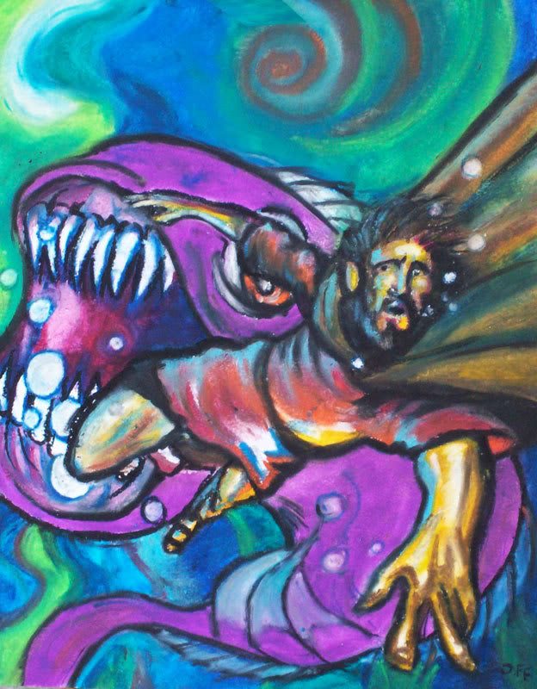
Jonah
Historical Background
Jonah lived in the reign of Jeroboam II
Nature of the book
History, legend, allegory?

Slide 29
Jonah
Message
“Don’t be like Jonah”
Narrow nationalism is unacceptable to God.
“What right do you have to be angry?”

