Slide 1
Jeremiah

Slide 2
Jeremiah
Who was Jeremiah?
Priest from Anathoth—An outsider, or an insider without the pedigree.
Where did he preach?
In Jerusalem (with letters to Babylon)
When did he preach?
627-586 (and ministered longer)

Slide 3
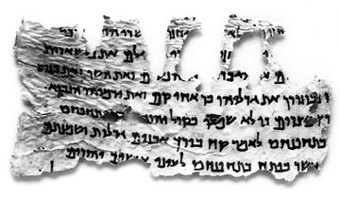
Structure, Text, Canon
Text
LXX is 15% shorter than MT
Dead Sea Scrolls show that different Hebrew versions existed.

Slide 4
LXX, 4QJer^{b,d}, and MT
Jeremiah 10:3-11
³For the customs of the peoples are worthless; they cut a tree out of the forest, and a craftsman shapes it with his chisel.⁴They adorn it with silver and gold; they fasten it with hammer and nails so it will not totter. ⁵Like a scarecrow in a melon patch, their idols cannot speak; they must be carried because they cannot walk. Do not fear them; they can do no harm nor can they do any good.
⁶No one is like you, O LORD; you are great, and your name is mighty in power. ⁷Who should not revere you, O King of the nations? This is your due. Among all the wise men of the nations and in all their kingdoms, there is no one like you. ⁸They are all senseless and foolish; they are taught by worthless wooden idols.
⁹Hammered silver is brought from Tarshish and gold from Uphaz. What the craftsman and goldsmith have made is then dressed in blue and purple—all made by skilled workers.
¹⁰But the LORD is the true God; he is the living God, the eternal King. When he is angry, the earth trembles; the nations cannot endure his wrath.
¹¹"Tell them this: `These gods, who did not make the heavens and the earth, will perish from the earth and from under the heavens.' "

Slide 5
Text, Canon
Canon
LXX and MT differ on order of chapters and verses.
Jer. 46-51 after Jer. 25:13a.
I will bring upon that land all the words that I have uttered against it, everything written in this book, (Jer. 46-51 here in LXX) which Jeremiah prophesied against all the nations. (Jer 25:13 ESV)

Slide 6
Text, Canon
Septuagint (LXX) and Masoretic Text (MT) differ significantly. What does this mean?
“The LXX. Version of this book is, in its arrangement and in other particulars, singularly at variance with the original. The LXX. omits 10:6-8; 27:19-22; 29:16-20; 33:14-26; 39:4-13; 52:2, 3, 15, 28-30, etc. About 2,700 words in all of the original are omitted. These omissions, etc., are capricious and arbitrary, and render the version unreliable” (Easton Dictionary, http://mb-soft.com/believe/ txs/jeremiah.htm, accessed July 5, 2011).

Slide 7
Jeremiah 1:4-5
Now the word of the LORD came to me, saying, “Before I formed you in the womb I knew you, and before you were born I consecrated you; I appointed you a prophet to the nations.” Then I said, “Ah, Lord GOD! Behold, I do not know how to speak, for I am only a youth.” (ESV)

Slide 8
Jeremiah 1:7-9
But the LORD said to me, “Do not say, ‘I am only a youth’; for to all to whom I send you, you shall go, and whatever I command you, you shall speak. Do not be afraid of them, for I am with you to deliver you, declares the LORD.” Then the LORD put out his hand and touched my mouth. And the LORD said to me, “Behold, I have put my words in your mouth.”
Deut. 18:18: I will raise up for them a prophet like you from among their brothers; I will put my words in his mouth, and he will tell them everything I command him.

Slide 9
Message of Jeremiah

Slide 10
Message of Jeremiah
Judgment for Sin
Jeremiah 1:11-16
“Almond branch” (shaqed)
“Watching” (shoqed)
“Boiling Pot”

Slide 11
Jeremiah 2:9-13—The Two sins
Therefore I still contend with you, declares the LORD, and with your children's children I will contend. For cross to the coasts of Cyprus and see, or send to Kedar and examine with care; see if there has been such a thing. Has a nation changed its gods, even though they are no gods? But my people have changed their glory for that which does not profit. Be appalled, O heavens, at this; be shocked, be utterly desolate, declares the LORD (ESV).

Slide 12
Jeremiah 2:9-13—The Two sins
For my people have committed two evils: they have forsaken me, the fountain of living waters, and hewed out cisterns for themselves, broken cisterns that can hold no water. (Jer 2:13 ESV)

Slide 13
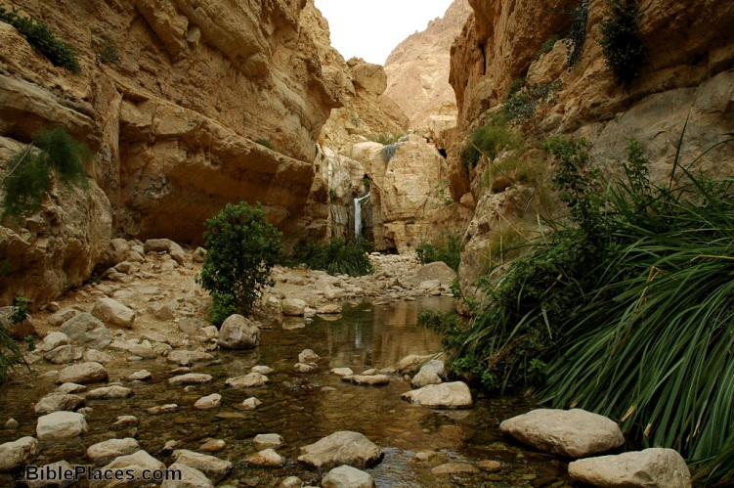
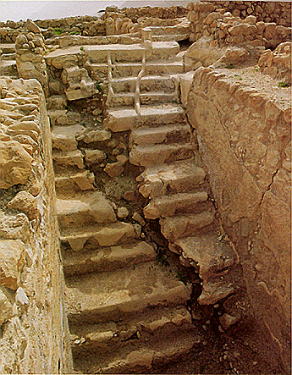
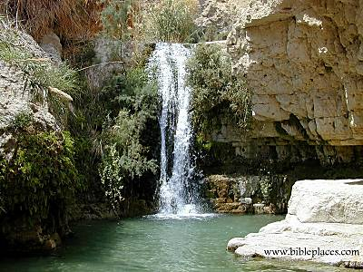
Jeremiah 2:9-13—The Two sins

Slide 14
Jeremiah 2:9-13—The Two sins
John 4
“Whoever drinks the water I give him will never thirst. Indeed, the water I give him will become in him a spring of water welling up to eternal life” (John 4:14 NIV).
We must seek our sustenance from Him.
Yet, where do we look?

Slide 15
Message of Jeremiah
Judgment for Sin
Jeremiah 7:1-11
Jeremiah 6:13-15

Slide 16
Jer 6:10-11—A Preacher's Heart?
¹⁰To whom can I speak and give warning? Who will listen to me?
Their ears are closed so they cannot hear.
The word of the LORD is offensive to them; they find no pleasure in it.
¹¹But I am full of the wrath of the LORD, and I cannot hold it in.
closed = lit., "uncircumcised"
offensive = Is it always?

Slide 17
Jer 6:13-15—A Preacher's Heart?
¹³“From the least to the greatest, all are greedy for gain; prophets and priests alike, all practice deceit.¹⁴ They dress the wound of my people as though it were not serious. ‘Peace, peace,’ they say, when there is no peace.”
Brueggemann: The leaders believed that their “policies and propaganda” brought a society that was “harmonious, properly functioning, and life-giving. But, says this poet: ‘It is a lie. It is not so’” (Like Fire in the Bones, 169).
Chaos, not peace abounded!

Slide 18
Jer 6:13-15—A Preacher's Heart?
¹⁵Are they ashamed of their loathsome conduct? No, they have no shame at all; they do not even know how to blush.
"Moral Sensitivity"--Brueggemann
"So they will fall among the fallen; they will be brought down when I punish them," says the LORD.

Slide 19
Jer 6:16—At the Crossroads
¹⁶This is what the LORD says:
“Stand at the crossroads and look; ask for the ancient paths, ask where the good way is, and walk in it, and you will find rest for your souls.
But you said, ‘We will not walk in it.’”

Slide 20
Message of Jeremiah
Messiah
Jeremiah 23:5-6
Zedekiah (“My Righteousness Yah” [zidqiyahu]
“Yahweh Our Righteousness” (Yahweh zidqenu)

Slide 21
Jer. 27-29
Which Prophet will really profit you?

Slide 22
Jer. 31
²⁷ See, a time is coming—declares the LORD—when I will sow the House of Israel and the House of Judah with seed of men and seed of cattle; ²⁸ and just as I was watchful (shaqad ) over them to uproot and to pull down, to overthrow and to destroy and to bring disaster, so I will be watchful (shaqad ) over them to build and to plant -- declares the LORD.

Slide 23
Jer. 31
³¹ See, a time is coming—declares the LORD—when I will make a new covenant with the House of Israel and the House of Judah. ³² It will not be like the covenant I made with their fathers, when I took them by the hand to lead them out of the land of Egypt, a covenant which they broke, though I espoused them—declares the LORD.

Slide 24
Jer. 31
³³ But such is the covenant I will make with the House of Israel after these days—declares the LORD: I will put My Teaching into their inmost being and inscribe it upon their hearts (=“minds”?). Then I will be their God, and they shall be My people. ³⁴ No longer will they need to teach one another and say to one another, “Heed (lit., “know”) the LORD”; for all of them, from the least of them to the greatest, shall heed (lit., “know”) Me—declares the LORD. For I will forgive their iniquities, And remember their sins no more. (Jer 31:31-34 TNK)

