Slide 1
Job & Qohelet

Slide 2
Job--Outline
Prologue (Satan?) 1:1-2:13
Job’s “Birthday Curse” 3:1-26
Dialogue with “Friends” 4:1-31:40
Elihu’s discourse 32:1-37:24
Yahweh’s 1st Speech 38:1-39:30
Job’s 1st Response 40:1-5
Yahweh’s 2nd Speech 40:6-41:34
Job’s 2nd Response 42:1-6
Epilogue (Really?) 42:7-17

Slide 3
Just a thought!
The Book of Job (and Ecclesiastes) is a book about what Brueggemann might call the “life in disorientation.”

Slide 4
Job—Purpose
Theodicy
Is God Righteous or Vindictive?
Protest
Example of Faith
James 5:11

Slide 5
Job—Theology
A New Worldview
How has his worldview changed?
God cannot be placed in a box!
“The Necessity of a Christ”
We need a redeemer/arbiter
Some will suffer!

Slide 6
Ecclesiastes--Title
“The Words of Qohelet”= קֹהֶ֣לֶת
“Ecclesiastes”—Greek from LXX (Ἐκκλησιαστοῦ)

Slide 7
Ecclesiastes--Structure
Prologue 1:1
Introduction 1:2-11
King’s Testimony 1:12-2:20
“Everything Under the Sun” 3:1-6:12
Various Wisdom Sayings 7:1-12:7
Conclusion 12:8
Epilogue 12:9-14

Slide 8
Ecclesiastes--Theology
Qohelet the Cynic
Confounded by the contradictions of life
A faithful cynic
Carpe Diem
Ecclesiastes and Job
Both attack the prevailing wisdom theology
Both build a new, synthetic theology and worldview

Slide 9
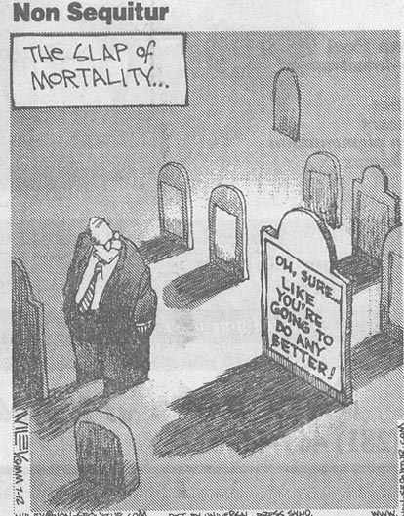
Qohelet?

