Slide 1
Joshua & Judges
“Into the Land”

Slide 2
Joshua—Outline
Crossing the Jordan (1-5)
Jericho, Bethel/Ai (6:1-8:29)
Covenant Ceremony (8:30-35)
“Southern Campaign” (9-10)
“Northern Campaign” (11)
Defeated Kings & Unconquered lands (12-13)
Division of the Land (14-22)
Rest and Warning (23)
Joshua’s Farewell (24)

Slide 3
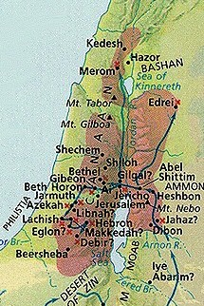
Joshua’s “Campaigns”

Slide 4
Unconquered Lands & Division of the Land

Slide 5
Conquest/Settlement Models
Military Conquest
Peasant Revolt
Settlement
Synthesis
Joshua led military campaigns.
Certain groups of people of the land did join Israel.
Israel was a nomadic people settling in the land.

Slide 6
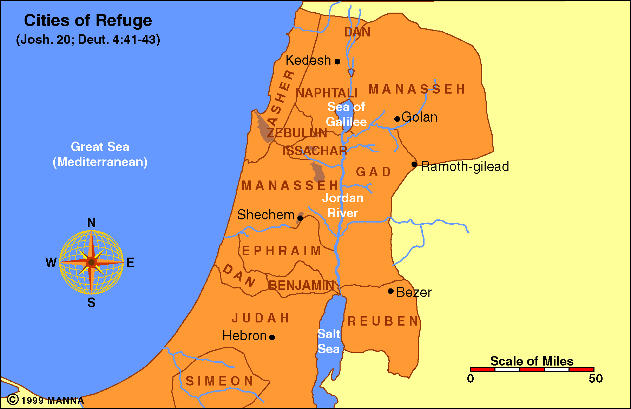
Joshua 20— Cities of Refuge

Slide 7
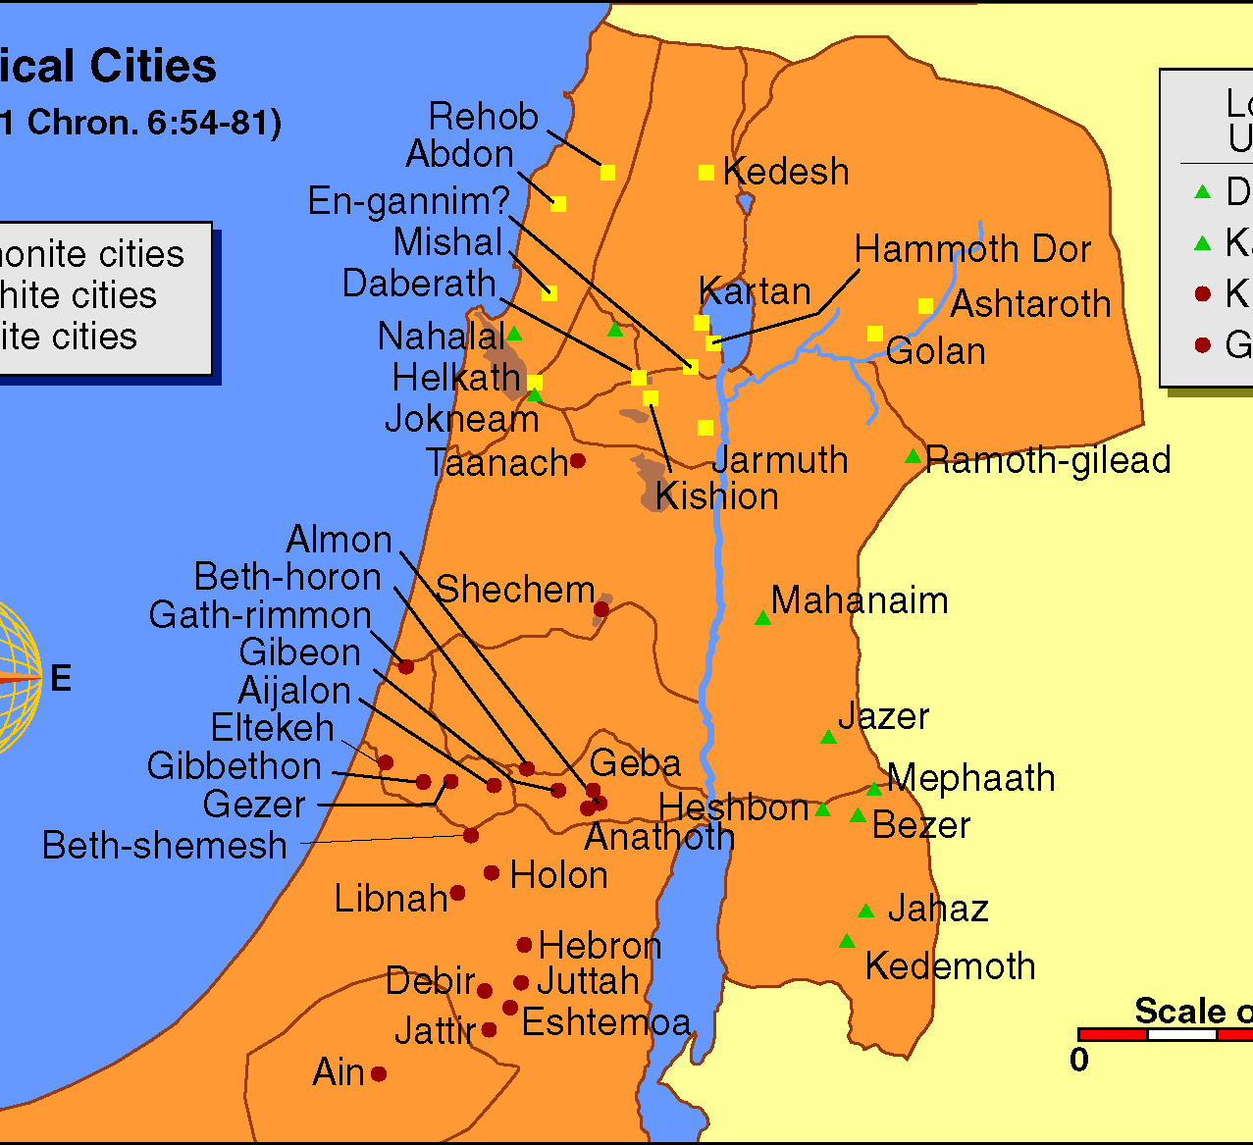
Joshua 21:1-42—Levitical Cities

Slide 8
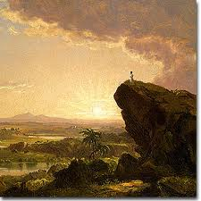
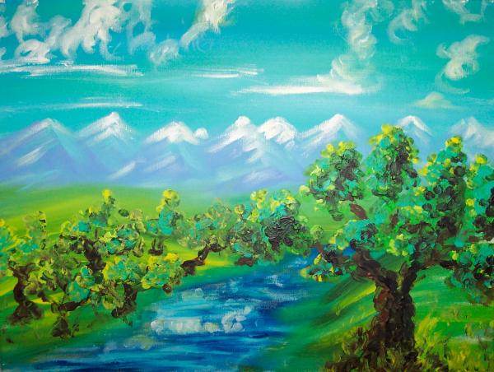
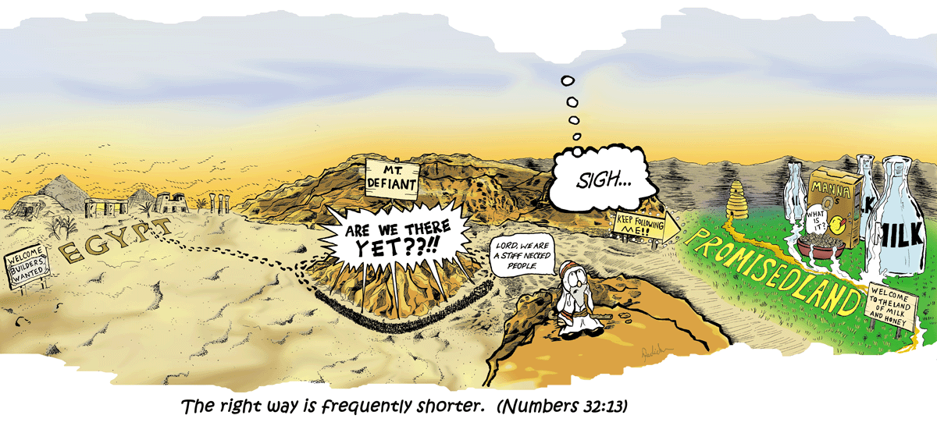
Theological Themes--Joshua
Promise & Fulfillment

Slide 9
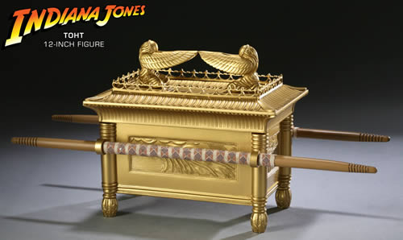
Theological Themes--Joshua
Covenant
Ark of the Covenant
Covenant Renewal

Slide 10
Theological Themes--Joshua
Rest
Relationship with YHWH, peace, blessings
Holiness/Purity
Sin must be removed.
Cherem (חֶרֶם)— “devoted to the LORD”

Slide 11
Judges—Introduction
“Judges”—shophetim שֹׁפְתִּים

Slide 12
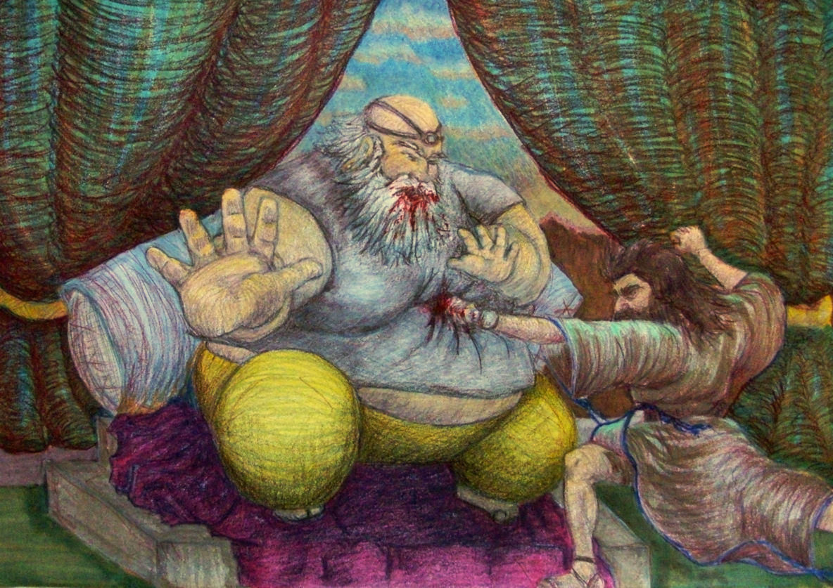
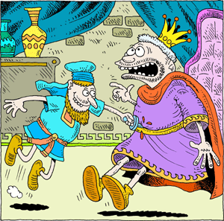
Judges: Outline of Contents
Conclusion of the “Conquest”
Summary of Period of the Judges
The “Judges”
Othniel, Ehud, & Shamgar (3:7-31)

Slide 13
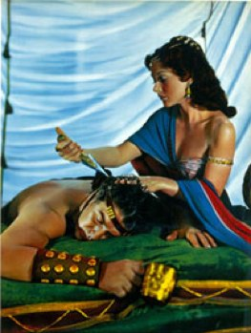
Judges: Outline of Contents
The “Judges”
Othniel, Ehud, & Shamgar (3:7-31)
Deborah (4-5)
Gideon (6-9)
Jephthah (10:6-12:7)
Samson (13-16)

Slide 14
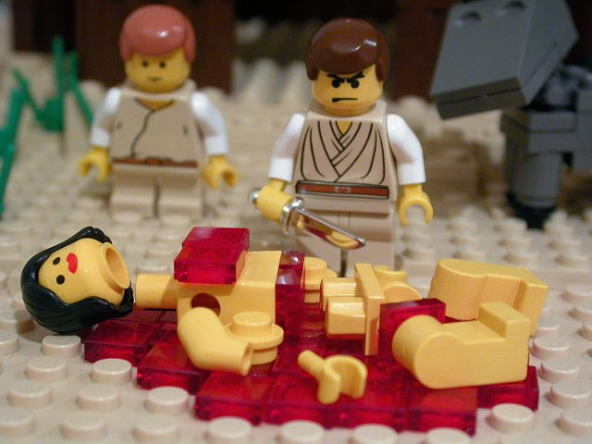
Judges: Outline of Contents
A Priest, Dan, a Concubine, & Tribal War

Slide 15
Judges: Outline of Contents
Judges 21:25—A Fitting Conclusion
“Israel had no king”
“Everyone did as he saw fit”
No Unity.
No morality.
No true worship of Yahweh.

Slide 16
Theological Themes--Judges
Purity
God had warned them that the Canaanites would be a snare, and . . .
THEY WERE!

Slide 17
Theological Themes--Judges
Rest
True rest comes from right relationship with God.
God
God will fight His battles.

Slide 18
Theological Themes—Judges and Missio Dei
Where is the world going?

