Slide 1
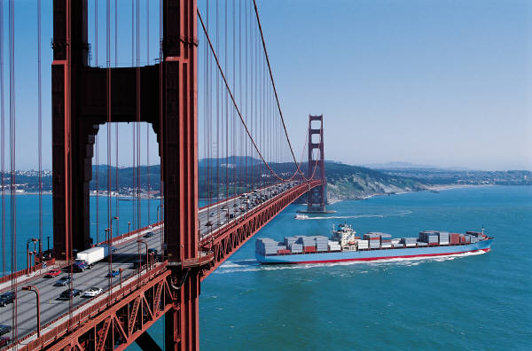
Deuteronomy
Bridge
Between
Two Ages

Slide 2
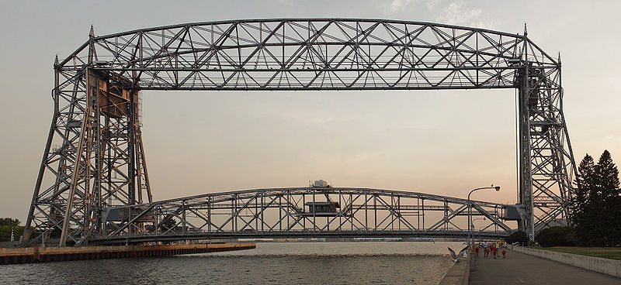
Introduction
Nature of Deuteronomy
Speech
Bridge between old and new.
Prophetic call to obedience.

Slide 3
Introduction
Or, (via Brueggemann, God Neighbor Empire) Deuteronomy
Is a copy. Dt. 17:18 says, keep “a copy” of “this Torah.” (Is it a copy or a new version?)
Deuteronomy is exegesis. Dt. 1:5 reads, “Moses undertook to expound this Torah.”
Deuteronomy is an “act of making contemporary.”
And Moses summoned all Israel and said to them, “Hear, O Israel, the statutes and the rules that I speak in your hearing today, and you shall learn them and be careful to do them. The LORD our God made a covenant with us in Horeb. Not with our fathers did the LORD make this covenant, but with us, who are all of us here alive today.” (Dt 5:1-3 ESV)

Slide 4
Introduction
Prophetic call to obedience.
“Justice”
NIV: 5 in Dt, 4 in rest of Pentateuch, 55 in prophets
ESV: 8 in Dt, 3 in rest of Pent. , 66 in prophets
“Righteousness”
NIV: 5 Dt, 1 in rest of Pentateuch, 69 in prophets
ESV: 9 Dt, 14 Pent., 121 in prophets
“Covenant”
NIV: 25 Dt, 20 Gen, 11 Ex, 8 Lev, 61 in prophets
ESV: 28 Dt., 26 Gen., Ex. 13, Lev. 10, 78 in prophets
“Hear”
NIV: 24 Dt, 10 in rest of Pentateuch, 108 in prophets
ESV: 37 Dt, 36 in Pent., 175 in prophets

Slide 5
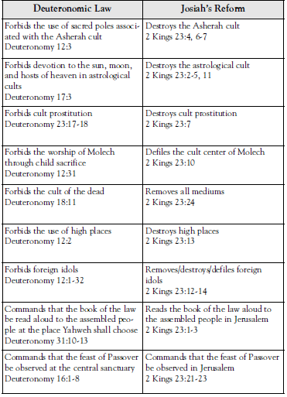
Introduction
Background of Deuteronomy
Josiah (2 Kings 22)
“Deuteronomistic History”

Slide 6
Introduction
Structure of Deut.—Covenant Treaty form?
Historical Prologue (Dt. 1-3)
Stipulations (Dt. 4-26)
Recording of Covenant (Dt. 27:1-8)
Blessings & Curses (Dt. 27:9-28:68)
Ratification/Renewal (Dt. 29)

Slide 7
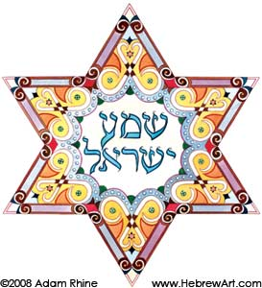
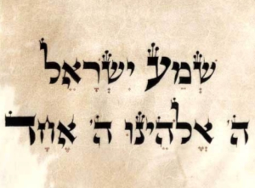
Outline of Deuteronomy
Historical Introduction
Covenant Obligations (4:1-11:32)
Shema (6:4)
“Remember”—16 in Deut., 13 in rest of Pent.
“Forget”—9 in Deut., 1 in rest of Pent.
“Teach”—11 in Deut., 5 in Ex., 1 in Lev.

Slide 8
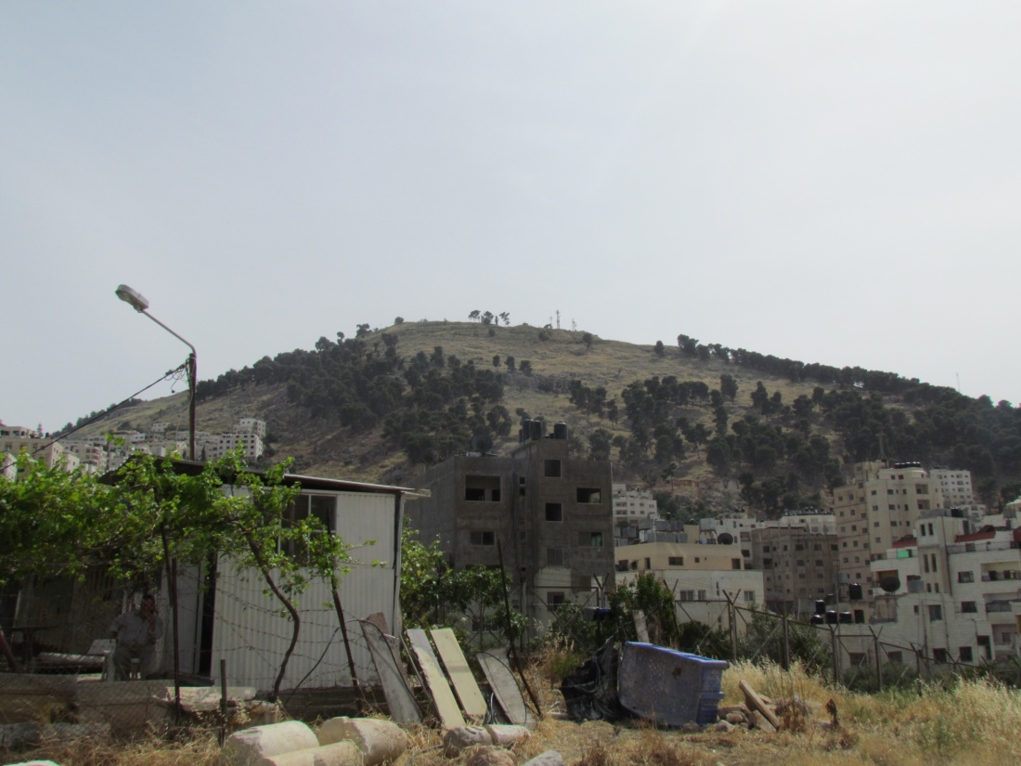
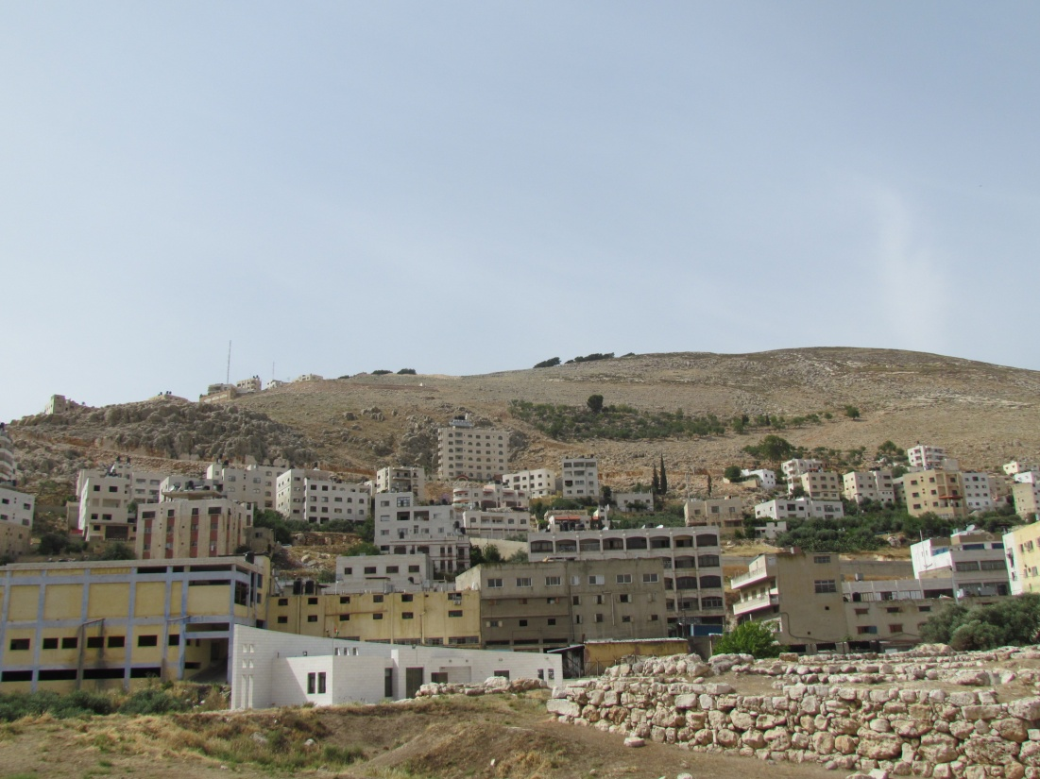
Outline of Deuteronomy
“Deuteronomic Code” (12:1-26:19)
Repetition with different application
“Will choose”—20 in Dt., nowhere else in Pent., 2 in Is.
Covenant at Shechem (Dt. 27-28)

Slide 9
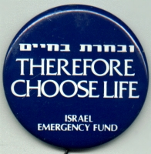
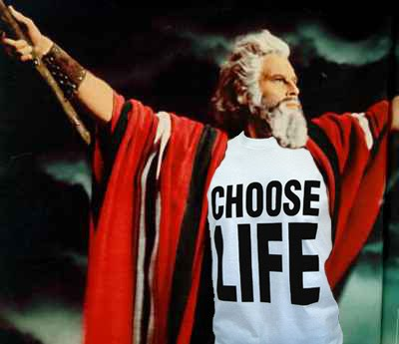
Outline of Deuteronomy
Life after curses—Covenant Renewal! (Dt 29-30)
“CHOOSE LIFE!”

Slide 10
Themes in Deuteronomy
Only the LORD (YHWH) is God
There is no other.
“The Lord your God” (200 of 390 times in OT)
God has chosen Israel
God’s “treasured possession” of all nations
The Land
As promise & threat?
God expects total commitment
Love the Lord

