Slide 1
Pentateuch 1
Introduction
&
Genesis

Slide 2
Pentateuch & “Torah”
“Pentateuch” means
“Five scrolls” or “five volumes”
“Torah” has a variety of meaning
The Pentateuch includes many types of literature (not just law)

Slide 3
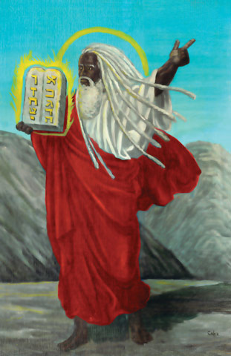
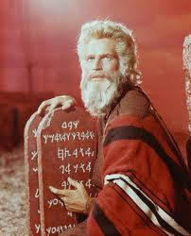
Critical study of the Pentateuch
Who wrote the Pentateuch?
Moses?
Lasor, Hubbard, Bush: “complexity”

Slide 4
Critical study of the Pentateuch
Who wrote the Pentateuch?
“Authorship” or “Composition”
Bruegg. , (Intro. to OT, 17): “appropriation & transformation”

Slide 5
Critical study of the Pentateuch
Documentary Hypothesis
Julius Wellhausen
Four sources
J = Jahwist/Yahwist, 950-850
E = Elohist, 750-700
D = Deuteronomist, late 7th-6th century
P = Priestly, 6th-5th century

Slide 6
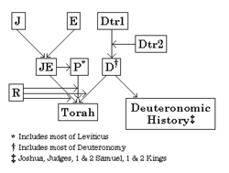
Critical study of the Pentateuch
From New World Encyclopedia.

Slide 7
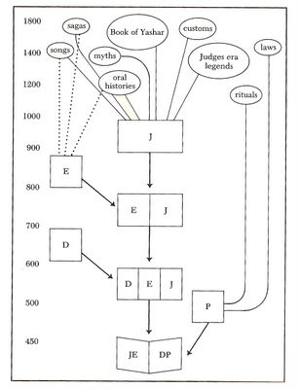
Critical study of the Pentateuch

Slide 8
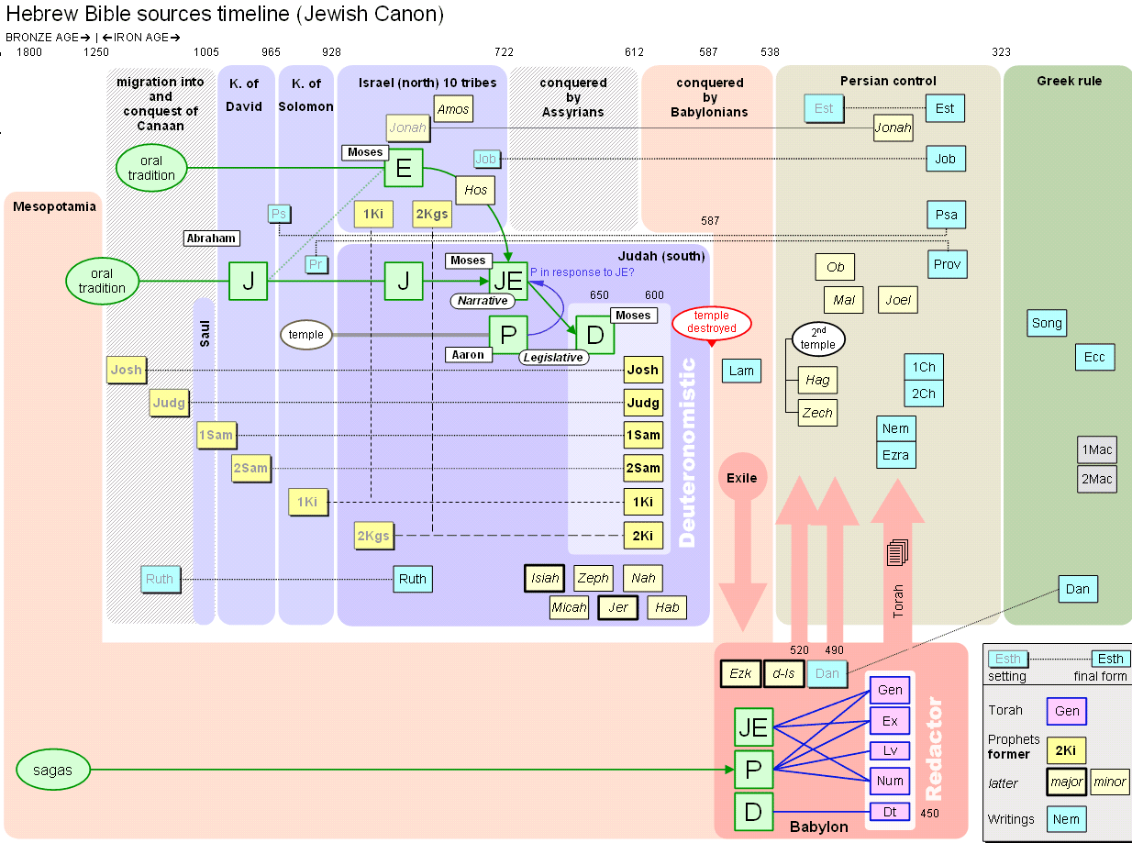
Critical study of the Pentateuch

Slide 9
Documentary Hypothesis--Problems
“There is at the present moment no consensus whatever about when, why, how, and through whom the Pentateuch reached its present form, and opinions about the dates of composition of its various parts differ by more than five hundred years” (R. N. Whybray, Introduction to the Pentateuch, 12-13).

Slide 10
Critical study of the Pentateuch
Source/Redaction Criticism
Form Criticism—Herman Gunkel
Individual sections and literary forms
Tradition History—Gerhard von Rad
Traditions in the Pentateuch
Canonical Criticism—Brevard Childs
Final form of the canon
History of criticism

Slide 11
Theological Themes of the Pentateuch
Promise
Election
Deliverance
Covenant
Law
Land

Slide 12
Structure of Genesis--Toledoth
2:4— “The generations of heavens/earth”
5:1— “The generations of Adam”
6:9— “The generations of Noah”
10:1— “The generations of the sons of Noah”
11:10— “The generations of Shem”
11:27— “The generations of Terah”
25:12— “The generations of Ishmael”
25:19— “The generations of Isaac”
36:1, 9— “The generations of Esau”
37:2— “The generations of Jacob”

Slide 13
Primeval Prologue—Gen. 1-11
Primeval =
adj. Belonging to the first or earliest age or ages; original or ancient (www.dictionary.com)

Slide 14
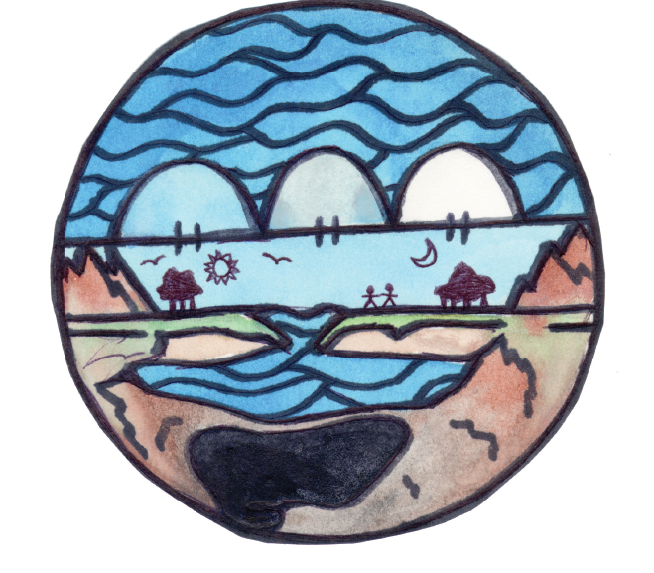
Ancient Cosmology

Slide 15
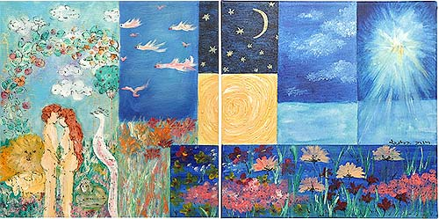
Creation—Gen. 1-2

Slide 16
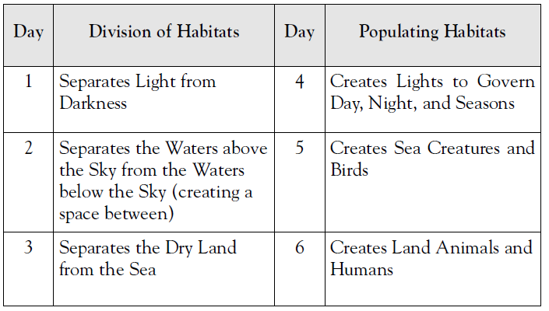
Primeval Prologue—Creation Days

Slide 17
Creation and the Enuma Elish
Creation
God is the creator (bara בָּרָא)
A single God of creation is unique to the ANE.
Creation is orderly & planned.

Slide 18
Creation and the Enuma Elish
Humanity is apex of creation
Man is created in “God’s image.”
Conscience, Self-awareness, spiritual discernment
Man is given dominion over creation.
Man is given a special companion, woman.
Creation is good, but . . . .

Slide 19
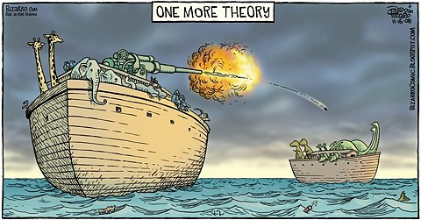
What happened to the dinosaurs?

Slide 20
Primeval Prologue—Theological Themes
Sin
Origin of evil?
Results of sin

Slide 21
Genesis 3:1

Slide 22
Genesis 3:1

Slide 23
Genesis 3:1

Slide 24
Genesis 3:1

Slide 25
Genesis 3:1

Slide 26
Genesis 3:1

Slide 27
Genesis 3:1

Slide 28
Genesis 3:1

Slide 29
Genesis 3:1

Slide 30
Genesis 3:1

Slide 31
Genesis 3:1

Slide 32
Genesis 3:1

Slide 33
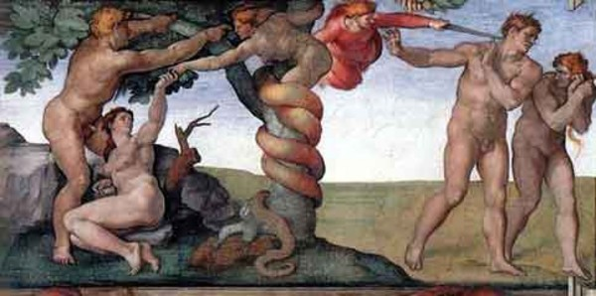
Primeval Prologue—Theological Themes
Judgment
Judgment in Eden
Judgment in a flood
Judgment at Babel

Slide 34
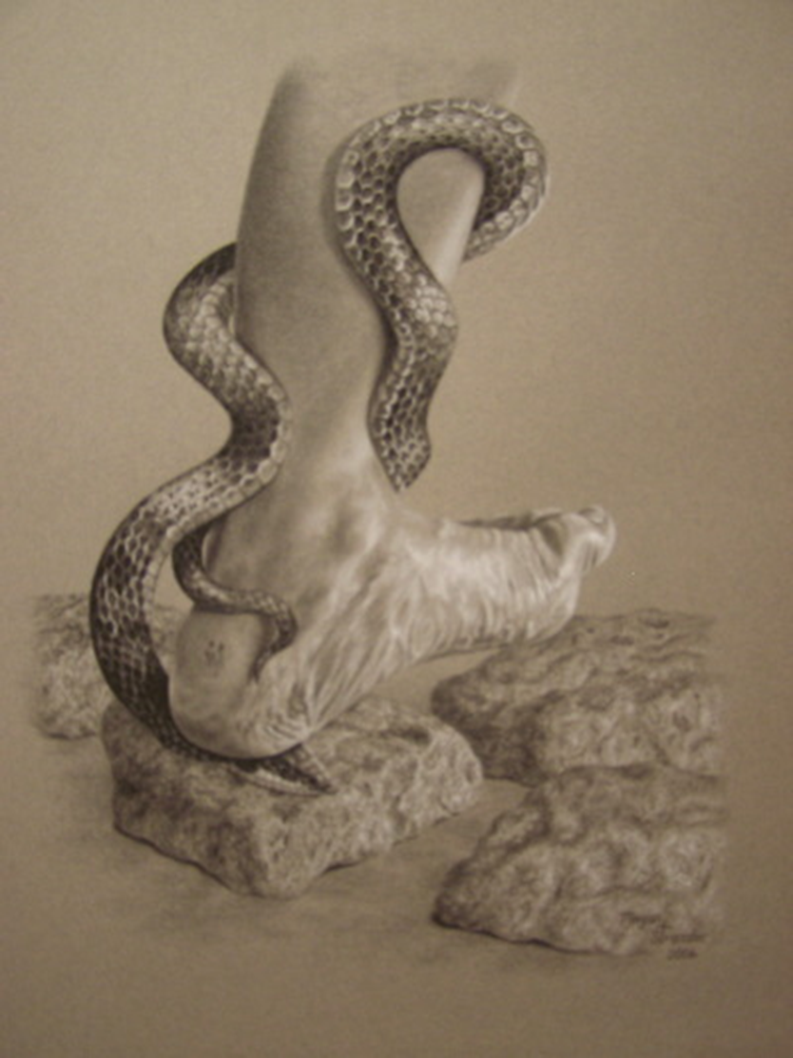
Primeval Prologue—Theological Themes
Grace
Grace in Eden
Grace after a flood
Grace at Babel

Slide 35
Primeval Prologue & Mission
Be fruitful and multiply
Have dominion

Slide 37
Patriarchal History—Gen. 12-50
Toledoth of Terah (11:27-25:11), includes:
Call & covenant of Abram
Abram’s journeys

Slide 38
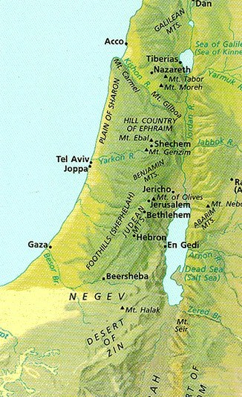
Patriarchal History—Gen. 11-50
Toledoth of Terah (11:27-25:11), includes:
Lot’s experiences
Ishmael’s birth
Promise, birth, and near sacrifice of Isaac

Slide 39
Patriarchal History—Gen. 11-50
Toledoth of Isaac (25:19-35:29), includes:
Esau’s forfeiting of birthright
Jacob’s theft of blessing
Jacob’s travels
Jacob’s marriages/ children
Jacob’s return/ reunion
Jacob’s encounters with God
Contrast between Abraham & Jacob?

Slide 40
Patriarchal History—Gen. 11-50
Toledoth of Esau (Gen. 36), includes:
Esau settles at Mt. Seir/Edom
Toledoth of Jacob (37:1-50:26), includes:
Joseph Story
Judah & Tamar
Patriarchal Blessings

Slide 41
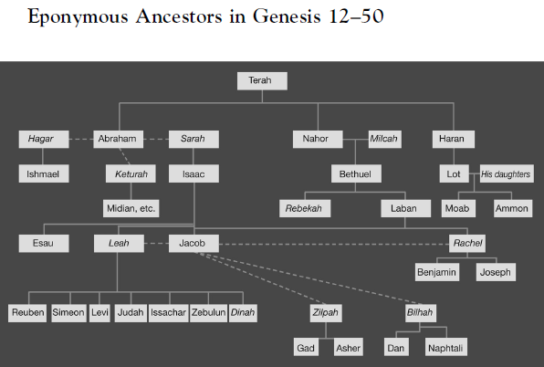

Slide 42
Patriarchal History— Theological Themes
Election and Promise
Call of Abram, contrast to Babel
Promise: land, nation, name, blessing to the whole earth
Ultimate irony (suspense?)
Genesis (and Pentateuch) ends with promise unfulfilled.

Slide 43
Patriarchal History— Theological Themes
Faith[fulness] and Righteousness
Righteousness comes from “faith[fulness]”
Patriarchal faith based upon promises of God
Were the patriarchs monotheistic?

Slide 44
Patriarchal History & Mission
Be a blessing!
Walk in God’s way:
justice and righteousness

