Slide 1
Psalms

Slide 2
What is the Book of Psalms
“Hymnbook” of the Second Temple
Devotional
“Davidic”—Title & Superscriptions
Not a part of the original psalm
Often differ in MT, LXX, & DSS
Set a possible historical context.

Slide 3
Structure of the Book of Psalms
Five books, each ending in a doxology
-Book I—1-41
Book II—42-72
Book III—73-89
Book IV—90-106
Book V—107-150

Slide 4
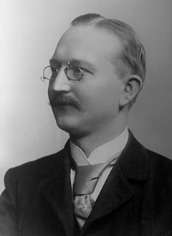
Critical Study of Psalms
Form-Criticism
Gunkel
Lament
Praise
Wisdom
Thanksgiving
Creation
Royal
Trust
Torah
Messiah

Slide 5
Critical Study of Psalms
Hymns
Psalm 117
Call to Worship—Praise the LORD, all nations! Extol him, all peoples!
Acts/Attributes of God—For great is his steadfast love toward us, and the faithfulness of the LORD endures forever.
Concluding call to praise—Praise the LORD! (ESV)

Slide 6
Critical Study of Psalms
Laments/Complaints
Prayers to God
"The Apostle"

Slide 7
Brueggemann and Psalms
Orientation
Disorientation
Wisdom
Torah
Creation
New Orientation
Lament
Thanksgiving
Enthronement

Slide 8
Psalm 13—Lament
Cry to God—How long, O LORD? Will you forget me forever? How long will you hide your face from me? How long must I take counsel in my soul and have sorrow in my heart all the day? How long shall my enemy be exalted over me?
Current Distress—Consider and answer me, O LORD my God; light up my eyes, lest I sleep the sleep of death, lest my enemy say, "I have prevailed over him," lest my foes rejoice because I am shaken.

Slide 9
Psalm 13—Lament
Cry to God
Current Distress
Affirmation of Trust—But I have trusted in your steadfast love;
Vow to praise—my heart shall rejoice in your salvation. I will sing to the LORD, because he has dealt bountifully with me. (ESV)

Slide 10
Critical Study of Psalms
Thanksgiving Songs
Psalm 92
92:1-3—Summary and resolve to give thanks
92:4-14—Reason for giving thanks
92:15—Summary of thanksgiving

Slide 11
Critical Study of Psalms
Royal/Messianic Psalms
Related to the king
Some were interpreted as messianic in DSS, Judaism, & NT.
Psalm 110
110:1—Most cited/alluded to OT text in the NT
110:1-3, 4-7—Two stanzas of promise and description of victory

Slide 12
Critical Study of Psalms
Wisdom Psalms
Characteristics of Wisdom Literature

Slide 13
Psalm 1
Blessed is the man who walks not in the counsel of the wicked, nor stands in the way of sinners, nor sits in the seat of scoffers; but his delight is in the law of the LORD, and on his law he meditates day and night. He is like a tree planted by streams of water that yields its fruit in its season, and its leaf does not wither. In all that he does, he prospers.
The wicked are not so, but are like chaff that the wind drives away. Therefore the wicked will not stand in the judgment, nor sinners in the congregation of the righteous; for the LORD knows the way of the righteous, but the way of the wicked will perish. (ESV)

Slide 14
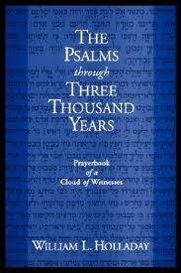
Psalm 23: Final Considerations
"An American Secular Icon" (Wm. Holladay, Psalms Through 3000 Years, 359-371)

Slide 15
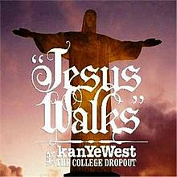
Psalm 23: Final Considerations
Kanye West "Jesus Walks"

Slide 16
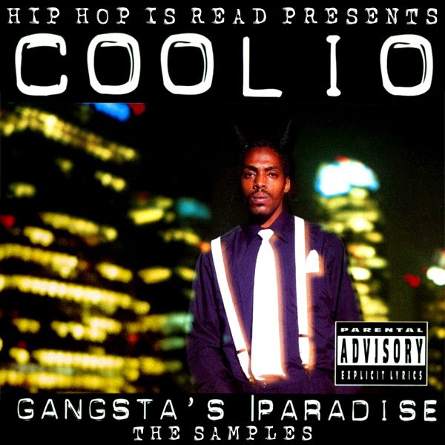
Psalm 23: Final Considerations
Coolio "Gangsta's Paradise"

Slide 17
Psalm 23: Final Considerations
"Pale Rider"

Slide 18
Psalm 23: Final Considerations
Funerals: life or death?
McCann (767): The psalm is "a psalm about living, for it puts daily activities, such as eating, drinking, and seeking security, in a radically God-centered perspective that challenges our usual way of thinking."

