Slide 1
1 & 2 Samuel
An
Introduction

Slide 2
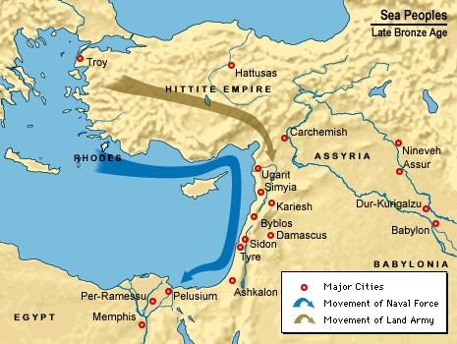
Historical Background
Power Vacuum—1200-900
Philistines/Sea Peoples

Slide 3
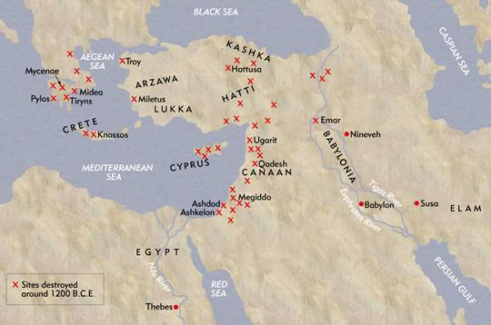
Historical Background
Philistines/Sea Peoples

Slide 4
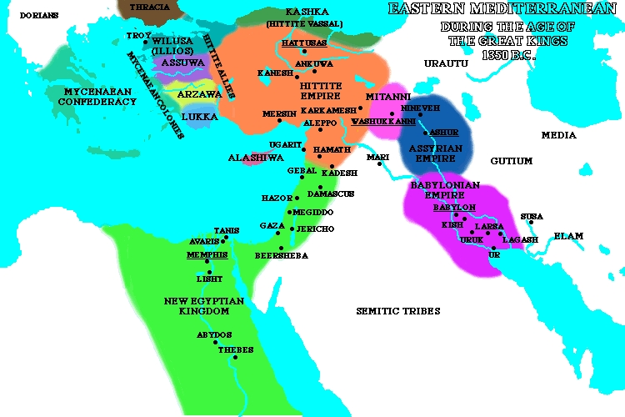
Historical Background

Slide 5
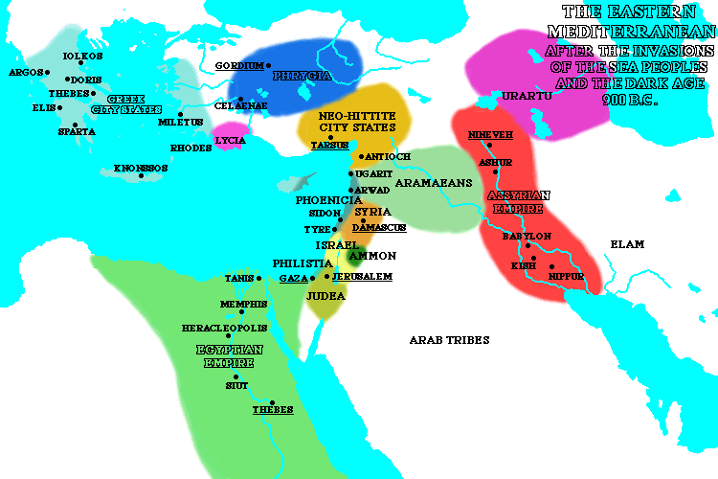
Historical Background

Slide 6
Chronology
Relative Dating
Absolute Dating
  C. 920 --Shishak/Sheshonq
  853 --Qarqar
  841 --Jehu & Shalmaneser
  734-732 --Syro-Ephraimite War
  722-721 --Fall of Samaria
  701 --Sennacherib Crisis
  597 --Nebuchadnezzar/Jerusalem

Slide 7
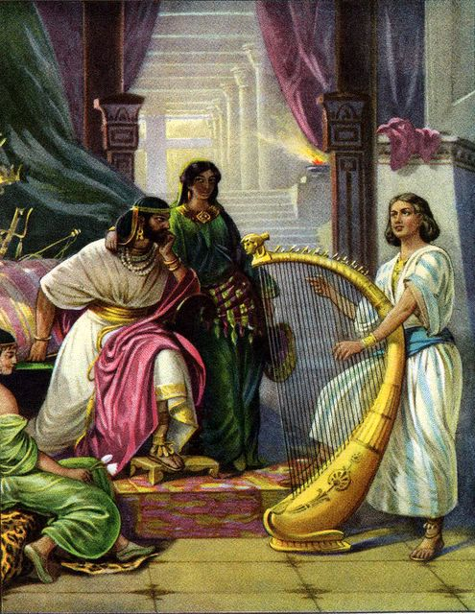
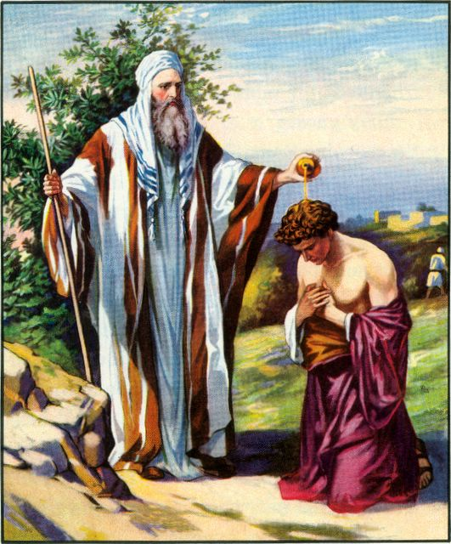
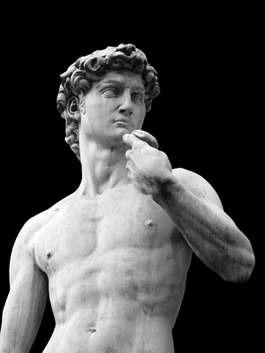
General Introduction
The story of three men
The story of kingship

Slide 8
Composition of 1 & 2 Samuel
Anonymous Authorship
Numerous sources used
Final form—Deuteronomistic History.
But much of it was probably written earlier.

Slide 9
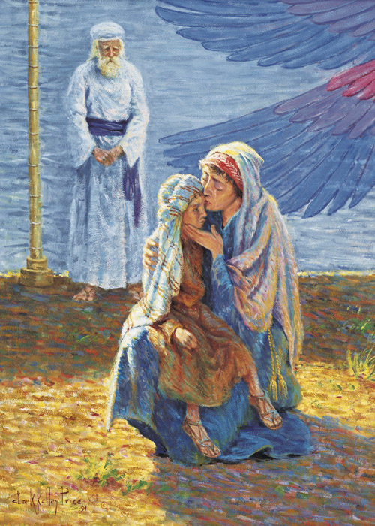
Rise & Fall of Kings & Kingdoms
Samuel (1 Sam. 1-7)
  Nazirite from birth (cf. Samson)
  Replaced Eli’s family at Shiloh
  Served in roles of prophet, priest, and king

Slide 10
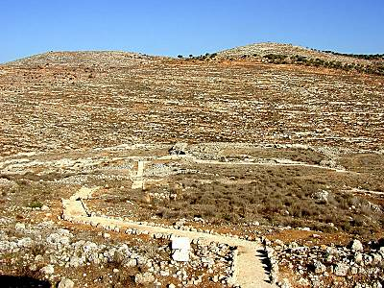
Shiloh--Tabernacle

Slide 11
Rise & Fall of Kings & Kingdoms
Samuel and Kingship (1 Sam. 8-12)
  The people demanded a king. Why?
  Samuel opposed kingship. Why?
  God?

Slide 12
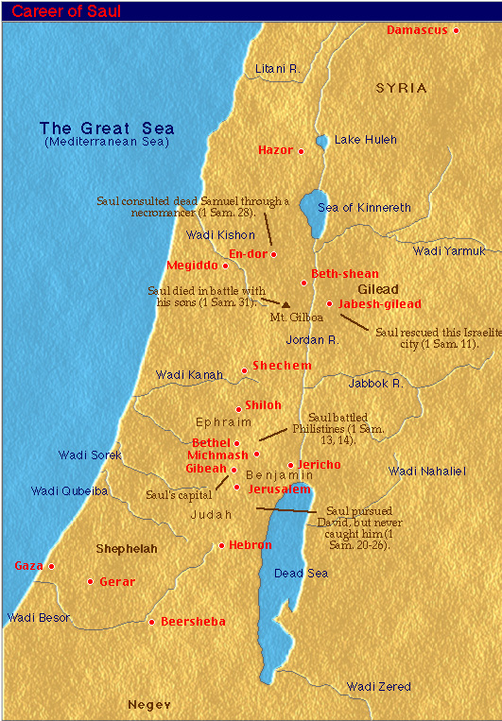
Rise & Fall of Kings & Kingdoms
Saul’s Kingdom
  Rise of Saul
  Fall of Saul (1 Sam. 13, 15-24, 28, 31)
    Saul offered a sacrifice
    Saul spared Agag and his livestock
    Saul became jealous of David
    Saul visited a medium

Slide 13
Conclusion
1 Chronicles 10:13-14
Saul died because he was unfaithful to the LORD; he did not keep the word of the LORD and even consulted a medium for guidance, ¹⁴ and did not inquire of the LORD. So the LORD put him to death and turned the kingdom over to David son of Jesse.

Slide 14
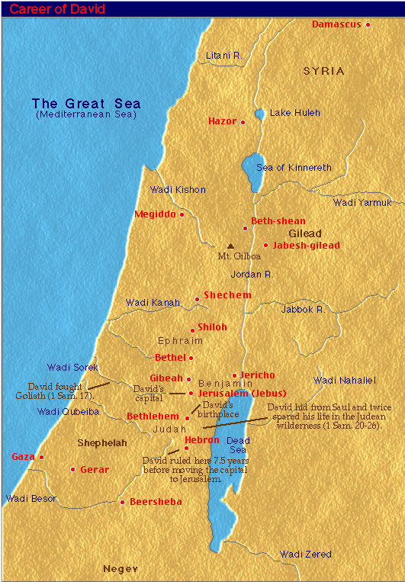
Rise & Fall of Kings & Kingdoms
Rise of David
  David served 2 kings
  He became king over Hebron

Slide 15
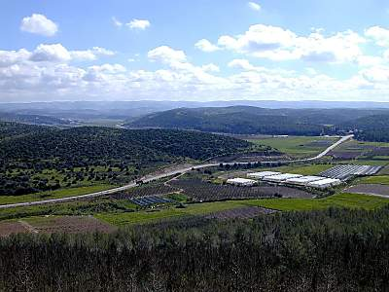
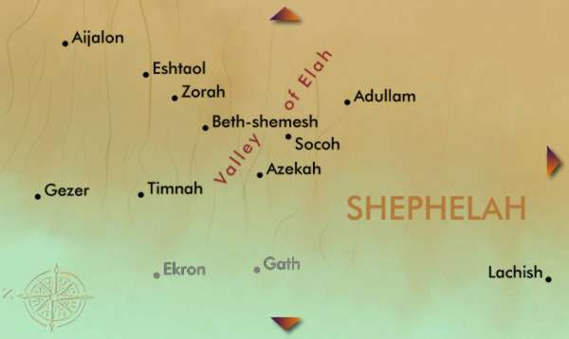
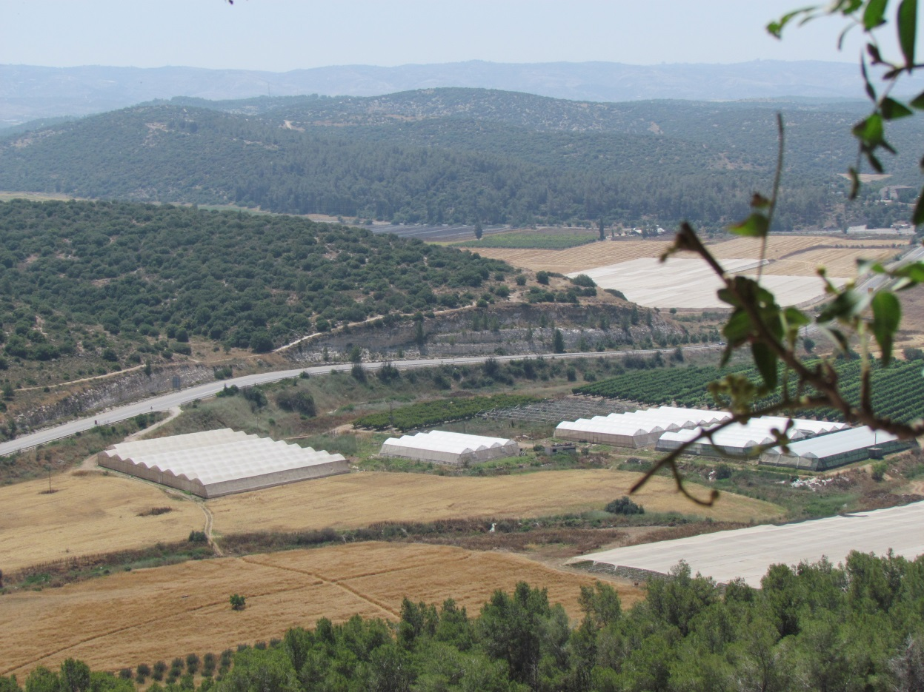
David & Goliath

Slide 16
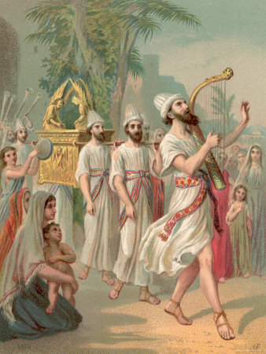
Rise & Fall of Kings & Kingdoms
Rise of David
  First act as king of all Israel
    Jerusalem
  David defeated all of Israel’s enemies.

Slide 17
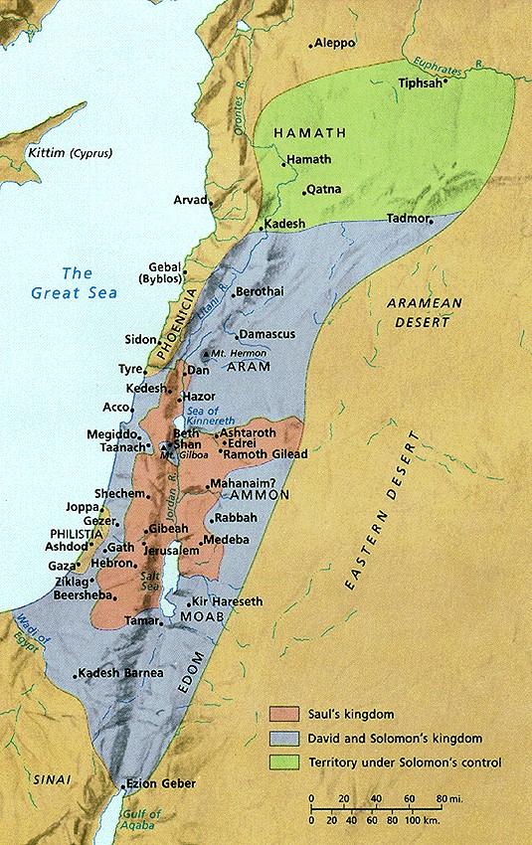
Kingdoms of Saul, David, & Solomon

Slide 18
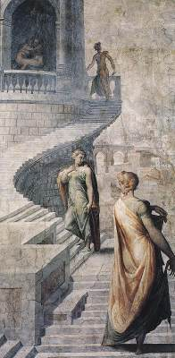
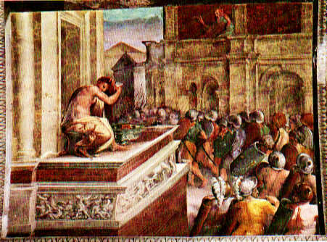
Rise & Fall of Kings & Kingdoms
Fall of David
  Bathsheba
    Why did this sin occur?

Slide 19
Rise & Fall of Kings & Kingdoms
Fall of David
  Succession of the throne
    Absalom’s revolt
    Adonijah set himself up as king.

Slide 20
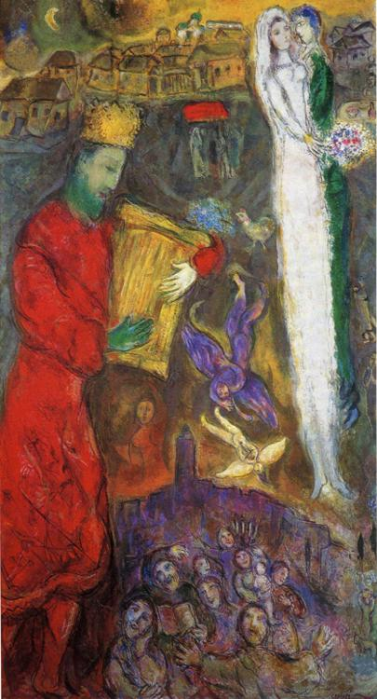
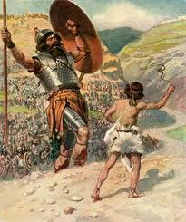
Memories of David

Slide 21
Rise & Fall of Kings & Kingdoms
Solomon’s Kingdom
  Rise of Solomon
    Solomon asked for wisdom (1 Kings 3)
    Effective administration & wealthy kingdom
  Fall of Solomon
    He became wealthy, powerful, & complacent

Slide 22
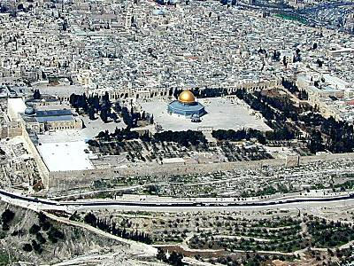
Jerusalem—Temple Mount

Slide 23
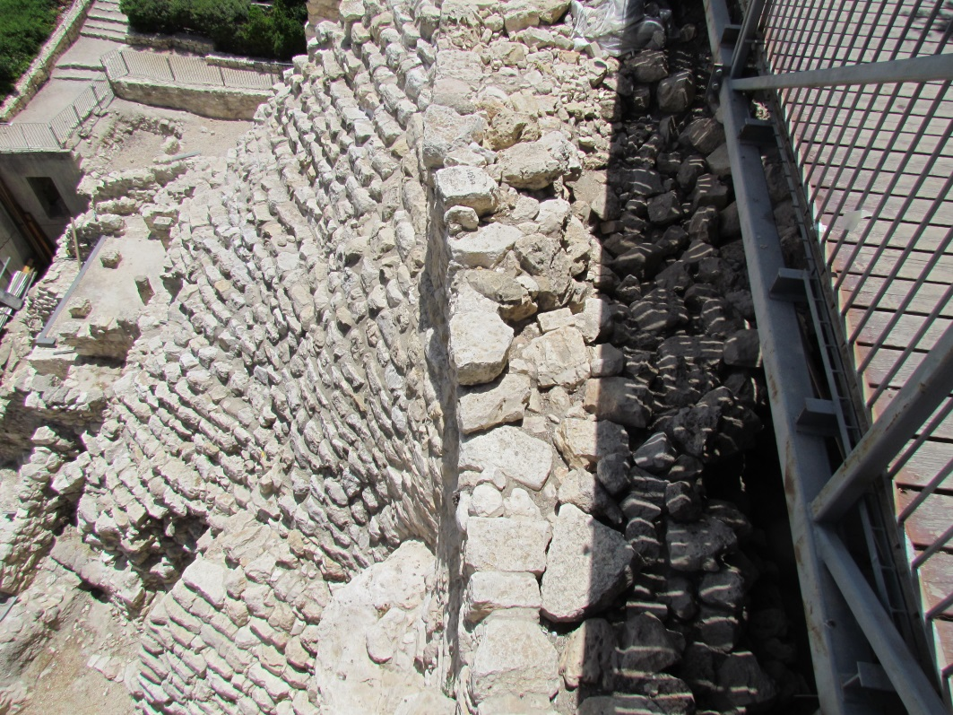
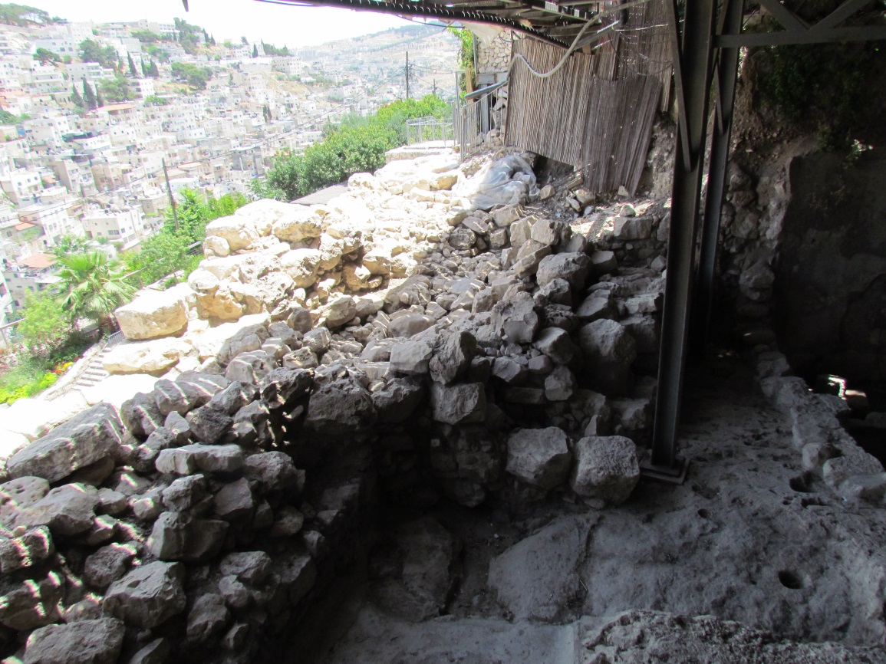
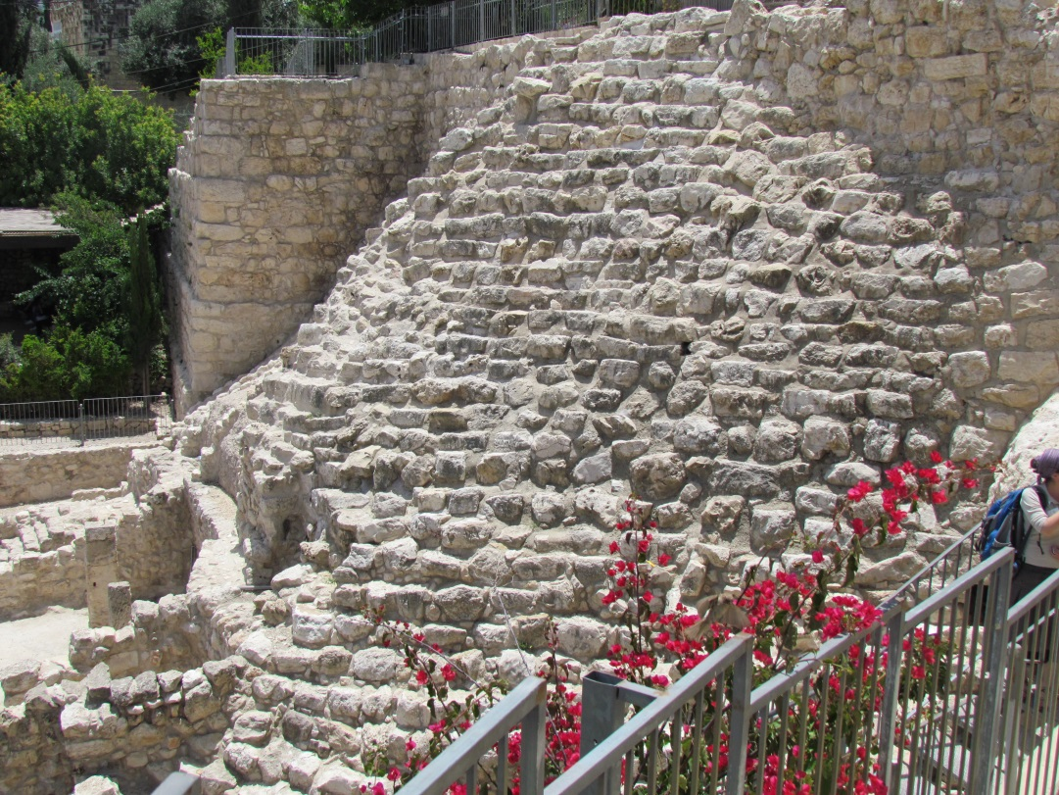
City of David

Slide 24
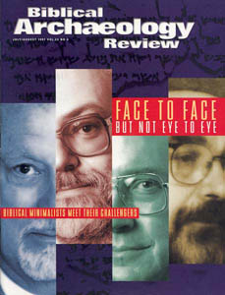
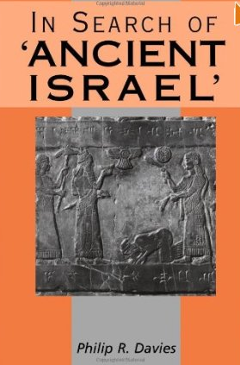
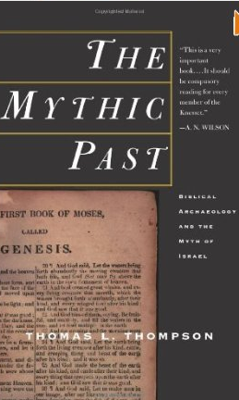
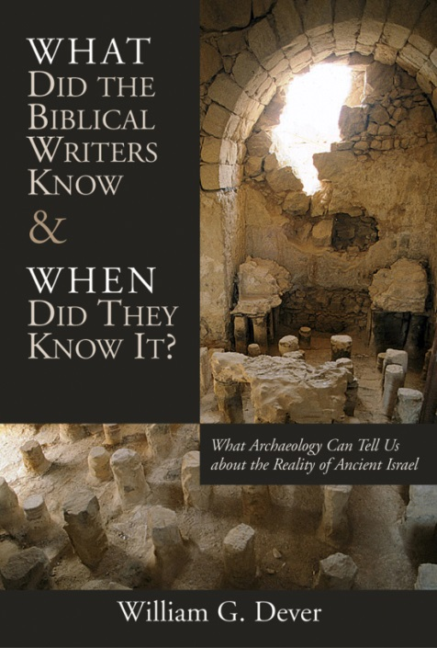
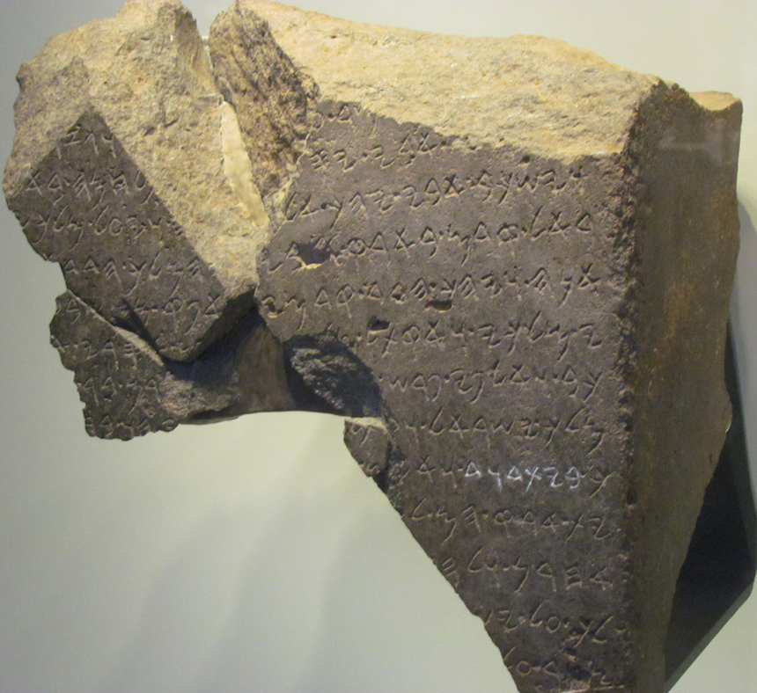
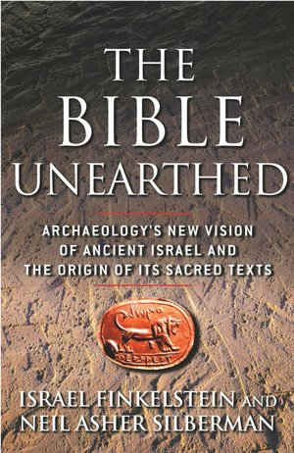
“Biblical Minimalism”

Slide 25
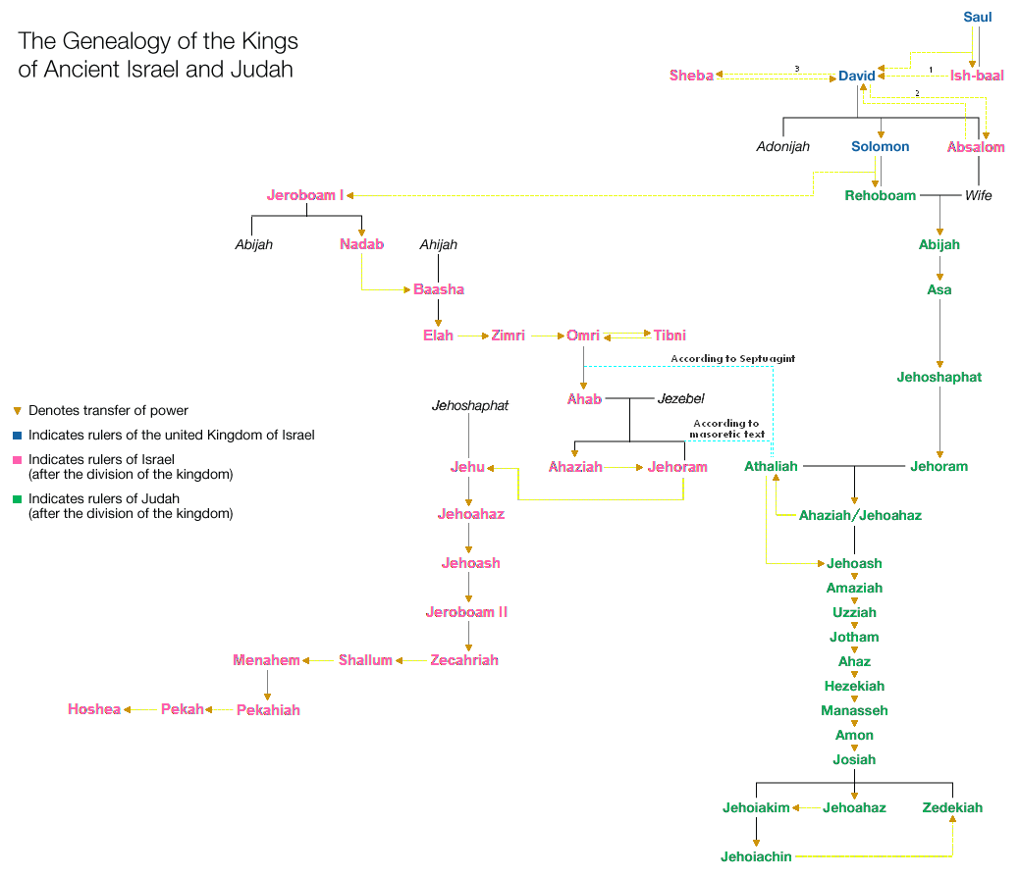
Rise & Fall of Kings & Kingdoms

Slide 26
Rise & Fall of Kings & Kingdoms

Slide 27
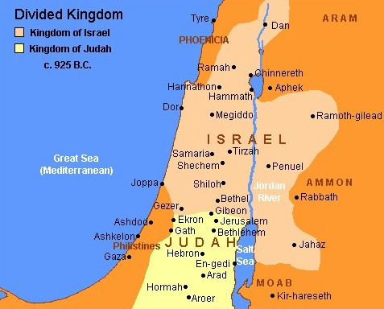
Rise & Fall of Kings & Kingdoms
Rehoboam & Jeroboam

Slide 28
Rise & Fall of Kings & Kingdoms

Slide 29
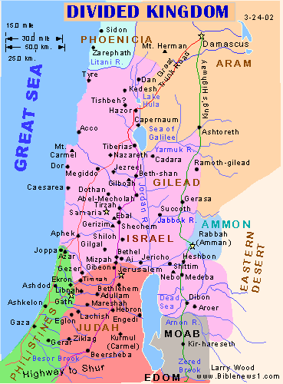
Rise & Fall of Kings & Kingdoms
Omri, Ahab, Jezebel, & Elijah
Bet Umri

Slide 30
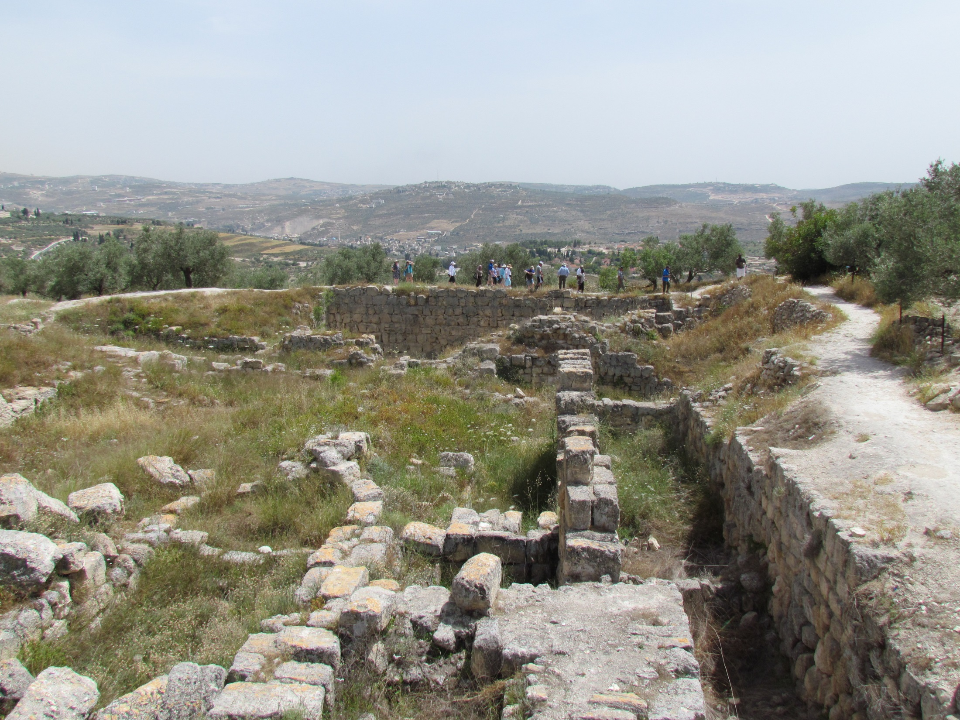
Rise & Fall of Kings & Kingdoms

Slide 31
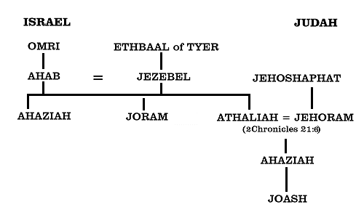
Rise & Fall of Kings & Kingdoms
Omri, Ahab, Jezebel, & Elijah
TYRE

Slide 32
Rise & Fall of Kings & Kingdoms
Omri, Ahab, Jezebel, & Elijah

Slide 33
Omri, Ahab, Jezebel, & Elijah

Slide 34
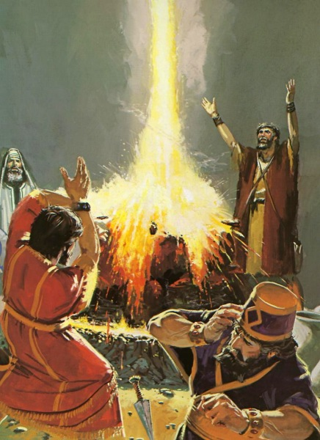
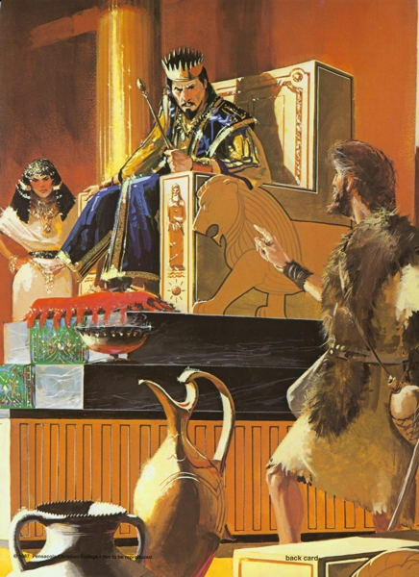
Rise & Fall of Kings & Kingdoms
Omri, Ahab, Jezebel, & Elijah

Slide 35
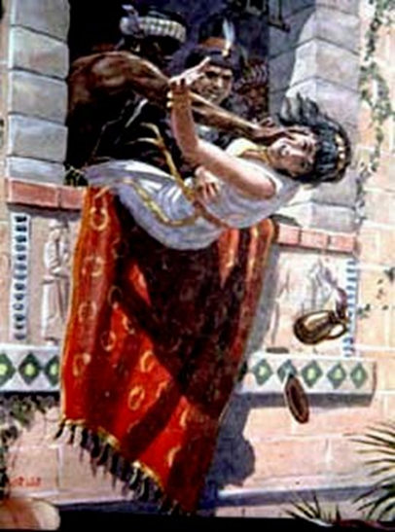
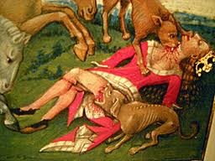
Rise & Fall of Kings & Kingdoms
Omri, Ahab, Jezebel, & Elijah

Slide 36
Rise & Fall of Kings & Kingdoms

Slide 37
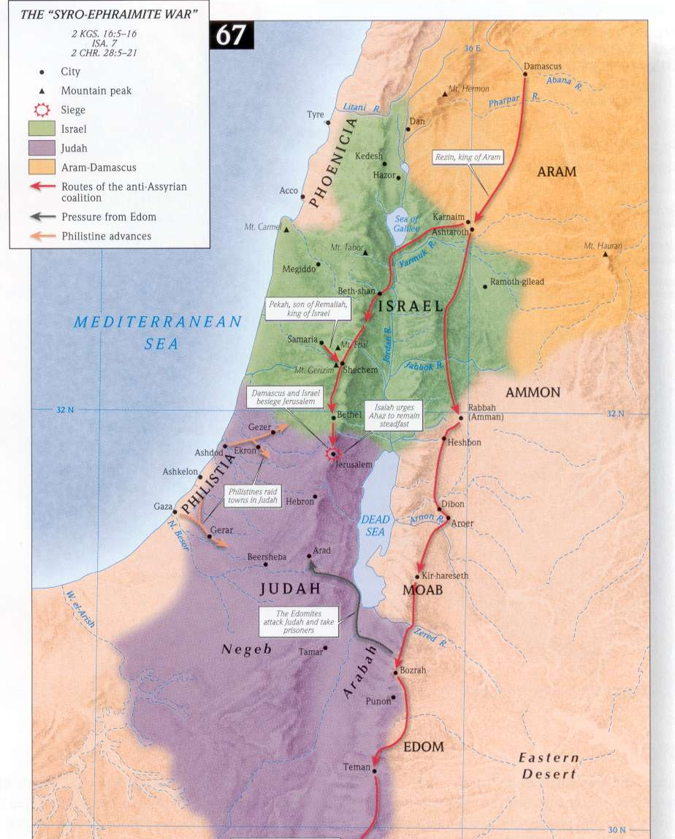
Rise & Fall of Kings & Kingdoms
Pekah, Rezin, Ahaz, Isaiah, the Assyrians, and Immanuel

Slide 38
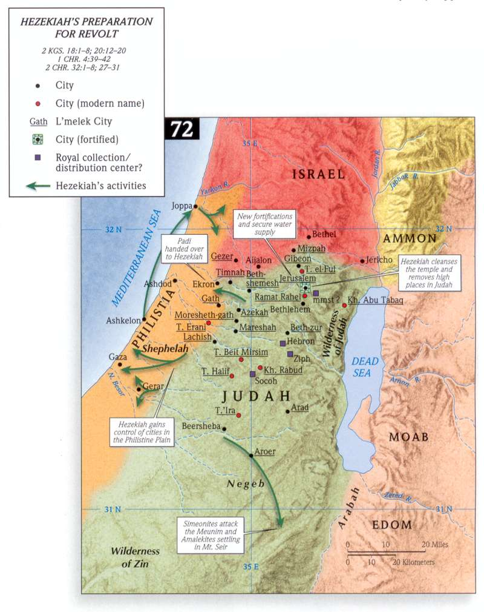
Rise & Fall of Kings & Kingdoms
Hezekiah, Sennacherib, & Isaiah

Slide 39
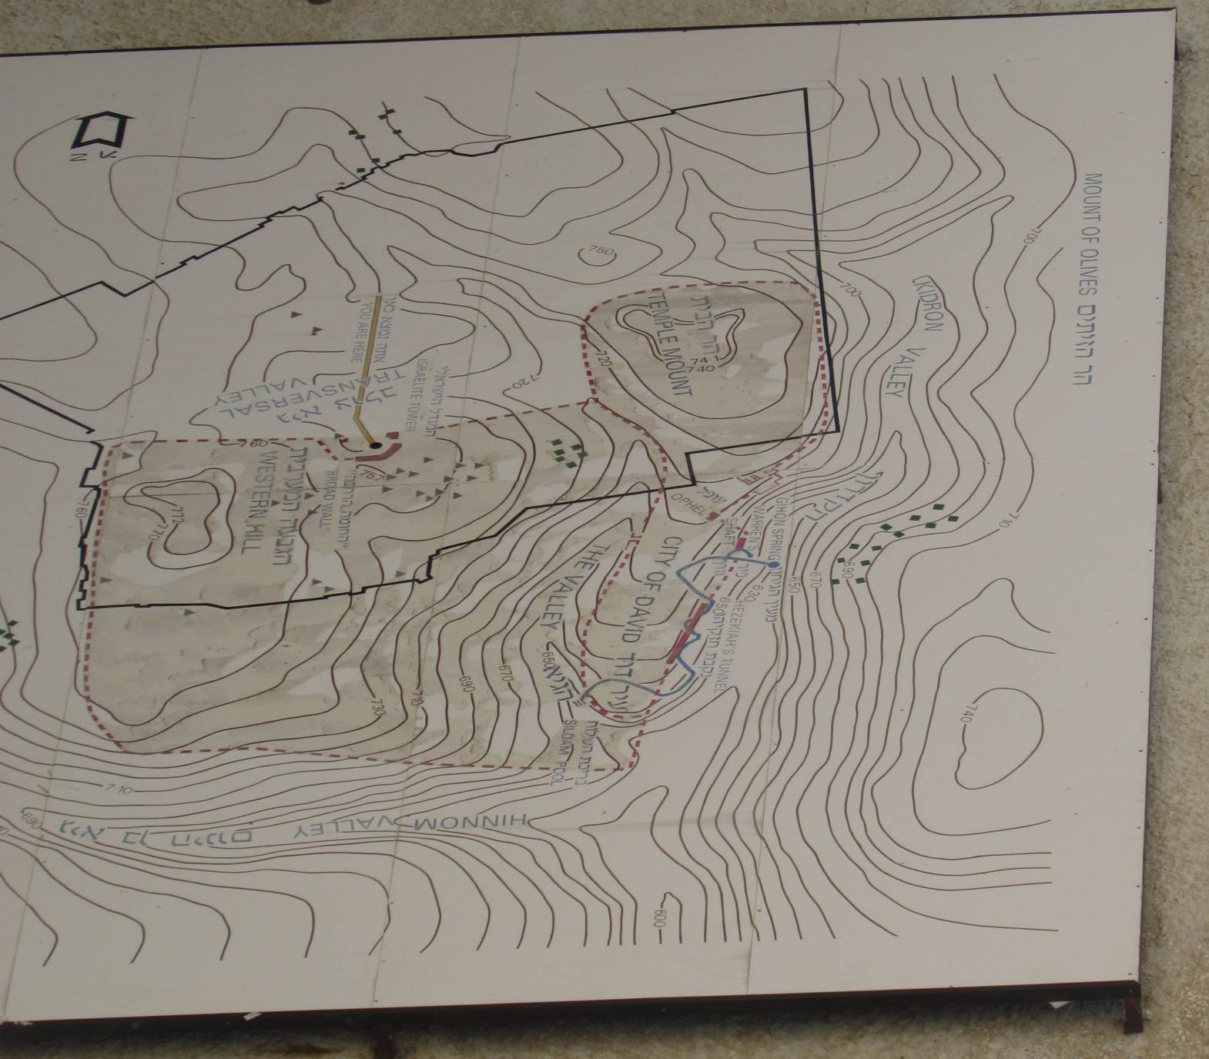
Rise & Fall of Kings & Kingdoms
Hezekiah, Sennacherib, & Isaiah

Slide 40
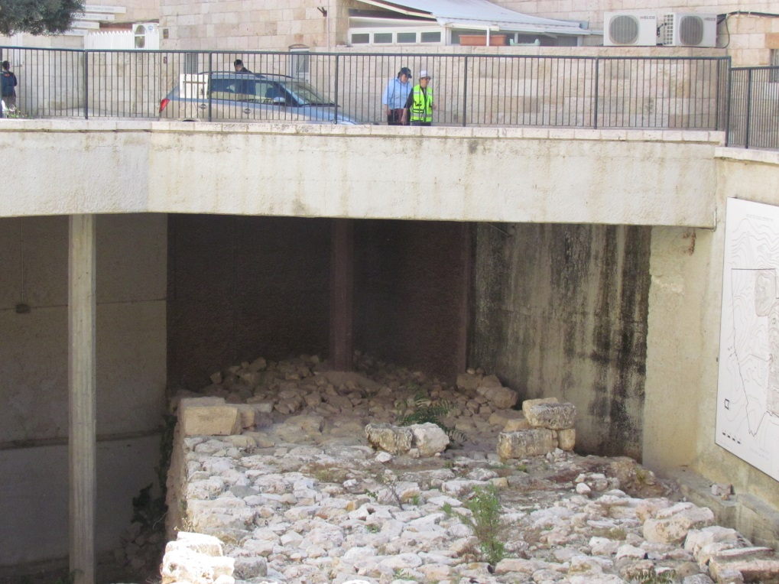
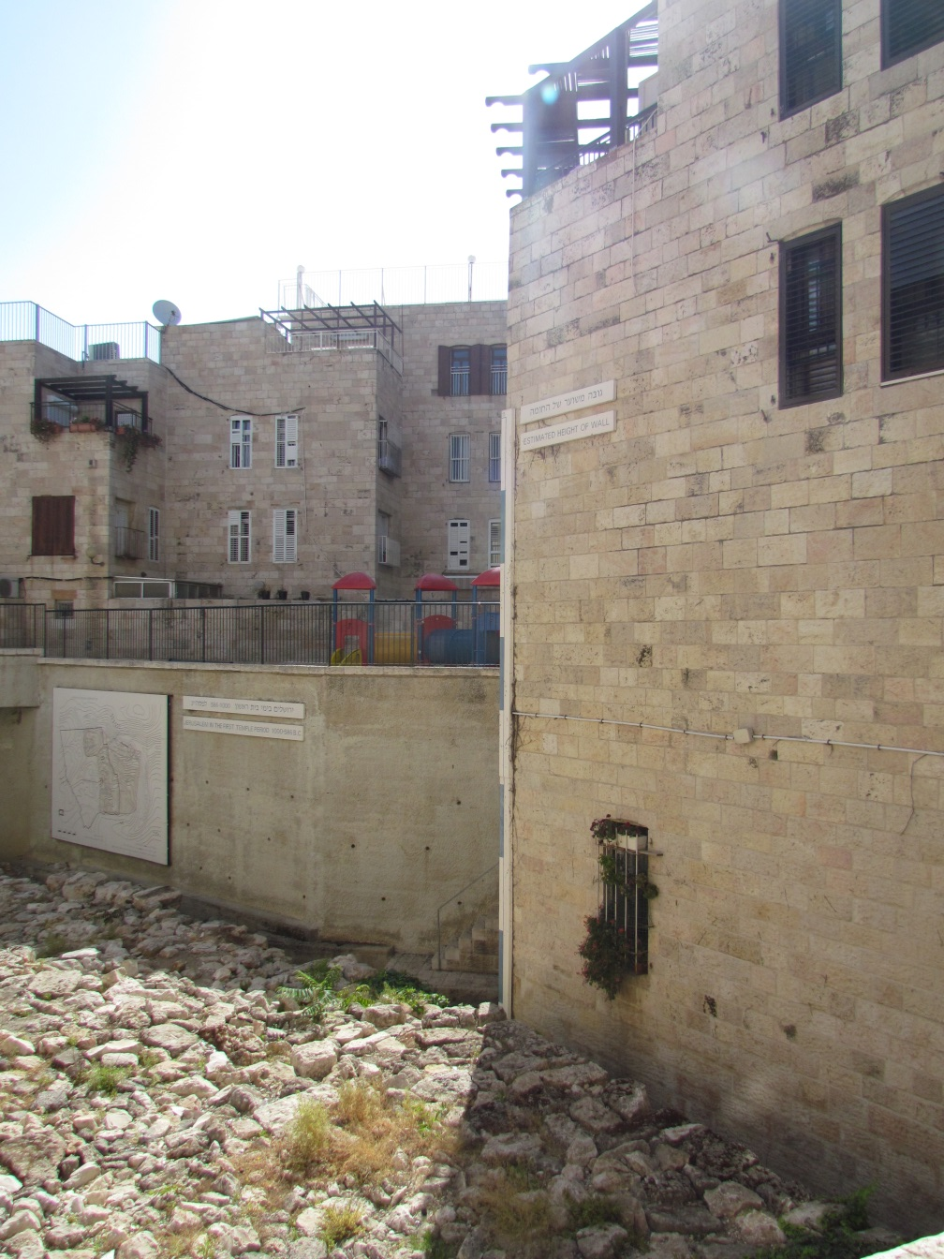
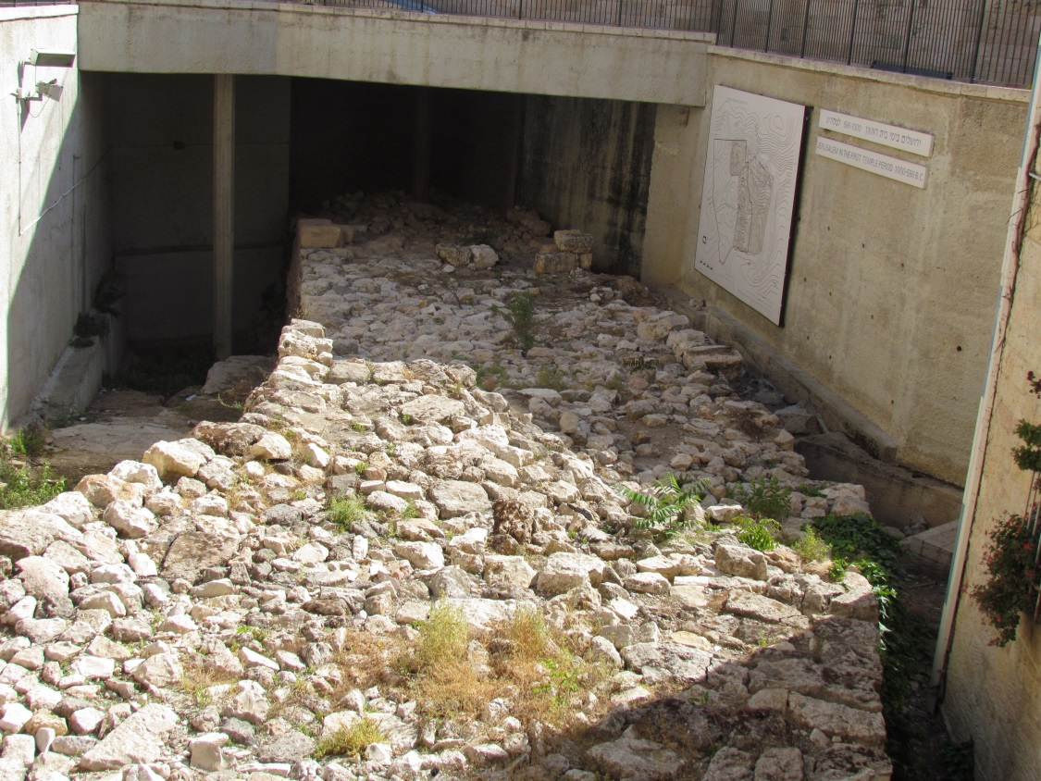
Rise & Fall of Kings & Kingdoms
Hezekiah, Sennacherib, & Isaiah

Slide 41
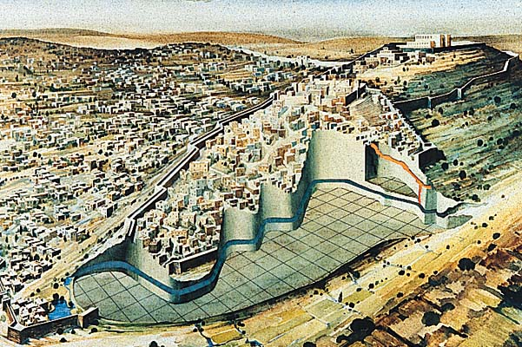
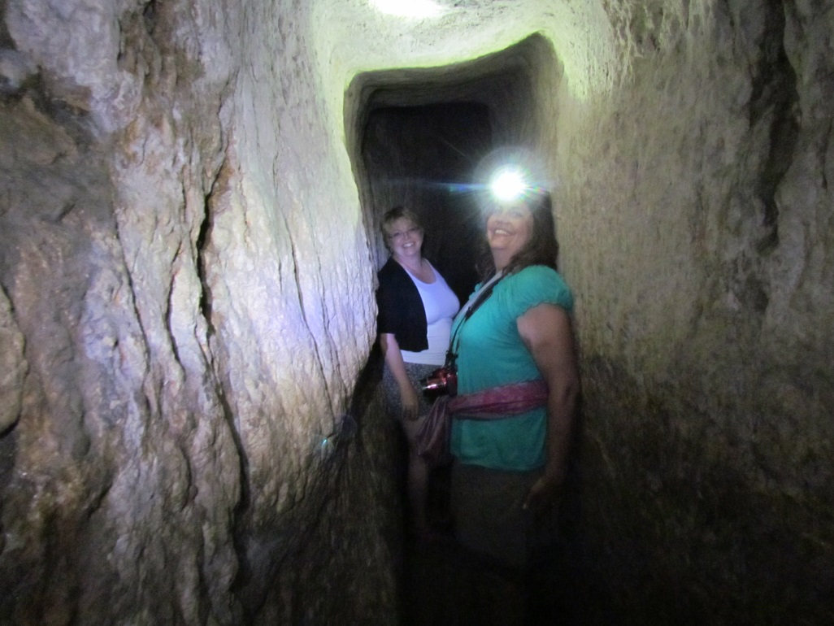
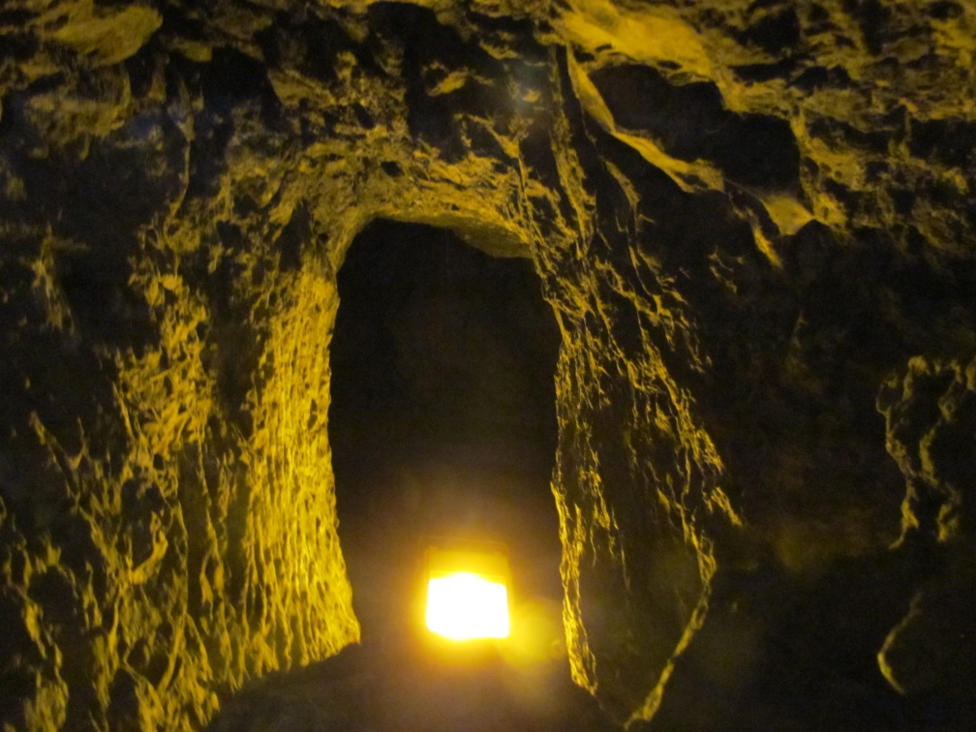
Rise & Fall of Kings & Kingdoms
Hezekiah, Sennacherib, & Isaiah

Slide 42
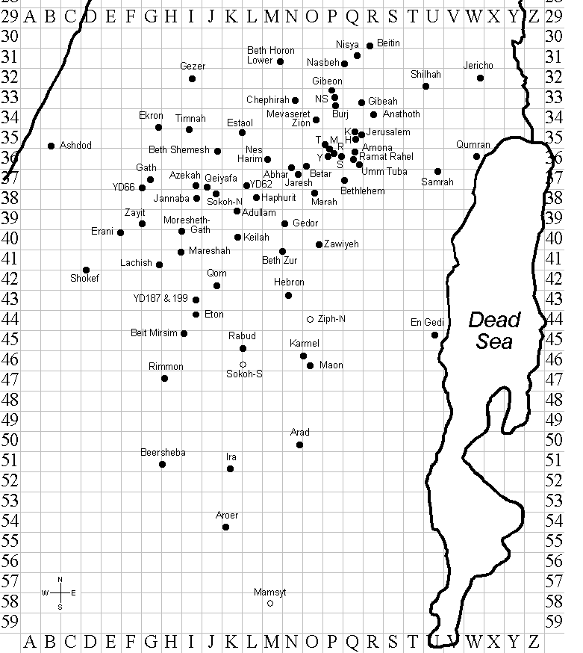
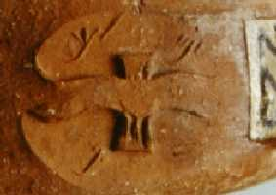
Rise & Fall of Kings & Kingdoms
Hezekiah, Sennacherib, & Isaiah—l^{e}melek jars

Slide 43

Rise & Fall of Kings & Kingdoms
Hezekiah, Sennacherib, & Isaiah

Slide 44


Slide 45
Rise & Fall of Kings & Kingdoms

Slide 46

Rise & Fall of Kings & Kingdoms

Slide 47


Rise & Fall of Kings & Kingdoms
Josiah

Slide 48

Rise & Fall of Kings & Kingdoms
Jehoiakim, Zedekiah, and Nebuchadnezzar

Slide 49
1. Prophecy
Roles of Prophets
  Royal Advisors—Shemaiah, Micaiah & Isaiah.
  [Missional?] Covenant Watchmen—Elijah, Ahijah, and various others.
    Justice in the land
    False worship
  Predictors of the future—Ahijah, Elijah, Elisha, Micaiah, Jehu ben Hanani, and others predicted the future.

Slide 50
2. The Davidic Monarchy
David as ideal king
  All kings are measured against David.
David’s Faithfulness
  . . . to Saul’s family
  . . . to Achish
  . . . regarding bloodguilt
  . . . toward God (“man after God’s heart”)

Slide 51
2. The Davidic Monarchy
The Eternal Throne
  David was promised a throne for eternity.
  This became a source of false hope for Judah.
  Source for messianic hope

Slide 52
3. Covenant
Mosaic Covenant
Davidic Covenant
  Ultimately the Mosaic covenant took precedence over the Davidic covenant = “prophetic religion”

Slide 53
4. Jerusalem
Temple
Inviolability of Jerusalem—
  2 Kings 19:34—The Lord will protect Jerusalem.
  This became a theological foundation for Judah.
  This became a source for complacency in Judah.

Slide 54
4. Jerusalem
Jeremiah 7:8-10—
“Behold, you trust in deceptive words to no avail. Will you steal, murder, commit adultery, swear falsely, make offerings to Baal, and go after other gods that you have not known, and then come and stand before me in this house, which is called by my name, and say, ‘We are delivered!’—only to go on doing all these abominations? (ESV)

