Slide 1
Megillot Song of Songs, Ruth, Lamentations, Esther

Slide 2
Megilloth
“Scrolls”
Ecclesiastes
Tabernacles
Song of Songs
Passover
Ruth
Shavuot/Weeks
Lamentations
9th of Ab
Esther
Purim

Slide 3
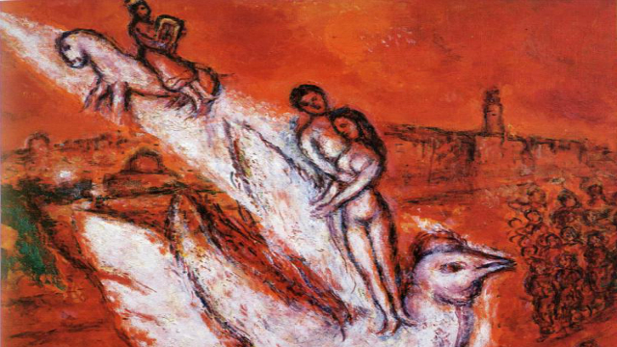
Song of Songs--Characters
The Woman = Bride, “beloved”
The Man = Groom, “the lover”
Friends, “Daughters of Jerusalem”

Slide 4
Song of Songs--Form
Drama
Allegory
Jewish & Christian
Why Allegory
To tone down the erotic nature of the book
To find meaning for erotic poetry in Scripture
Love Poems
ANE parallels

Slide 5
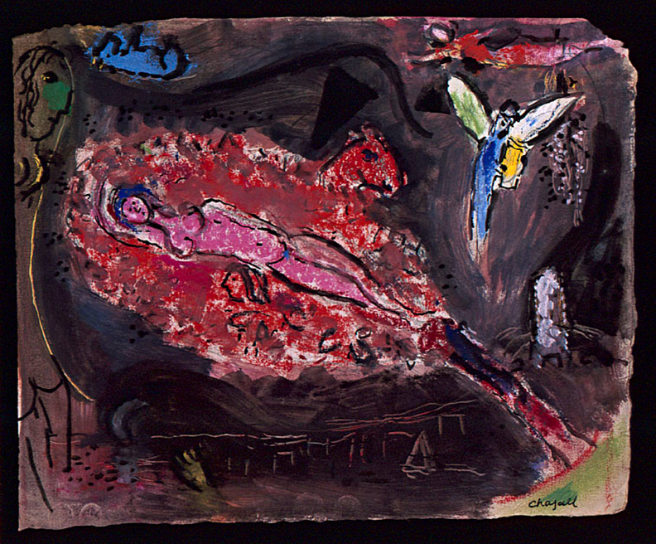
Song of Songs--Teaching
Her: I am a rose of Sharon, a lily found in one of the valleys.
Him: Like a lily among thorns, that is what she is; my dear is a captivating beauty among the young women. (2:1-2)

Slide 6
Song of Songs--Teaching
Her: My love is like an apple tree in a
wooded forest; he is a ripe tree among a grove of saplings, those young men. I sat beneath his ample shade, filled with such joy. I tasted the sweetness of his fruit and longed for more.
He placed me at his banquet table, for everyone to see that his banner over me declares his love. (2:3-4)

Slide 7
Song of Songs--Teaching
Him: Your stature is as elegant as a date palm tree, and your breasts are sweet, attractive, and round like clusters of its fruit. I say, “I will climb the palm tree;
I will take hold of its fruit.”
May your breasts be like clusters of
grapes, the fragrance of your mouth like fresh apples, and may your kisses satisfy like the best wine. (7:7-8)

Slide 8
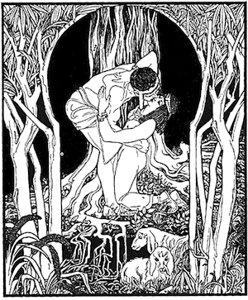
Song of Songs--Teaching
Traditional sexual values?
Celebrates sexual love and intimacy

Slide 9
Song of Songs--Teaching
Set me as a seal upon your heart,
as a seal upon your arm,
for love is strong as death,
jealousy is fierce as the grave.
Its flashes are flashes of fire,
the very flame of the Lord. (So 8:6 ESV).

Slide 11
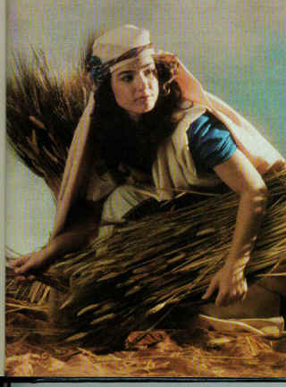
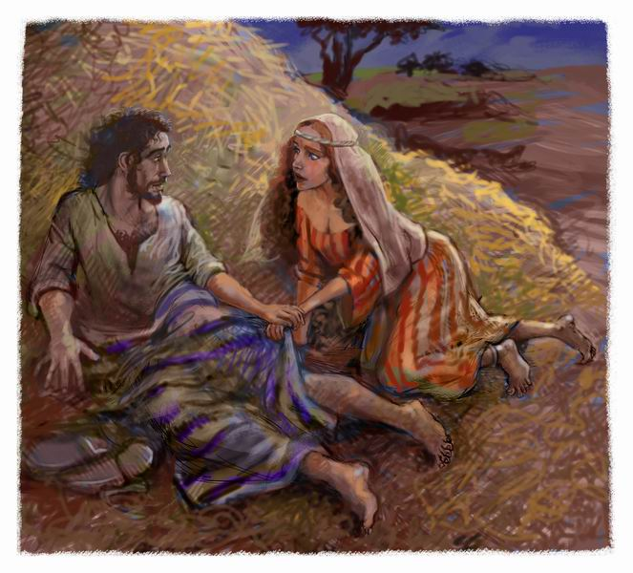
Ruth--Outline

Slide 12
Ruth--Outline
Elimelech’s Family
Ruth meets Boaz
Boaz as Kinsman-Redeemer
Ruth and Boaz Marry

Slide 13
Ruth—Theological Importance
The other side of the period of Judges
God’s sovereignty/providence
God’s compassion (for widows & orphans)
Kinsman Redeemer

Slide 14
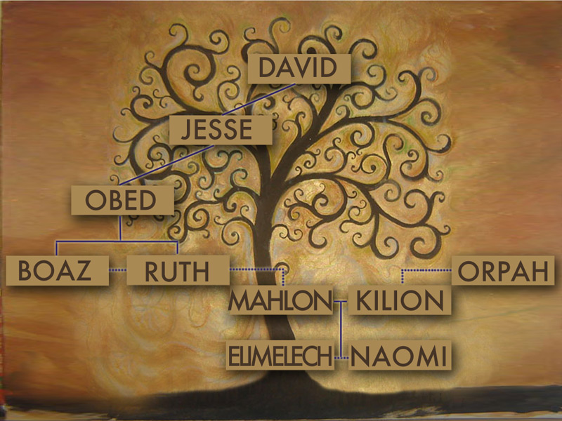
Ruth—Theological Importance
David! (and Moabites)

Slide 16
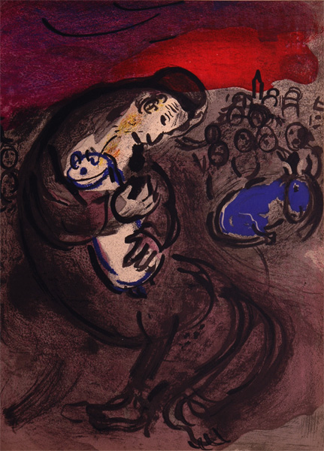
Lamentations—Authorship
Jeremiah?
Eyewitness to destruction
Understood theological significance

Slide 17
Lamentations—Summary
Lament for Destruction & Desolation of Jerusalem (Lam. 1-4)
Prayer to the LORD for renewal

Slide 18
Lamentations 3:19-24
I remember my affliction and my wandering, the bitterness and the gall
I well remember them, and my soul is downcast within me.
Yet this I call to mind and therefore I have hope:
Because of the LORD’s great love we are not consumed, for his compassions never fail.
They are new every morning; great is your faithfulness.
I say to myself, “The LORD is my portion; therefore I will wait for him.”

Slide 20
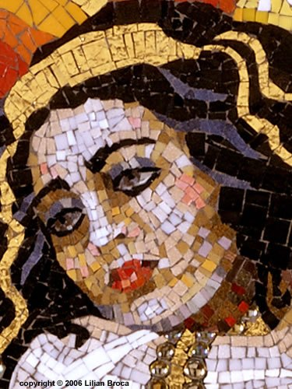
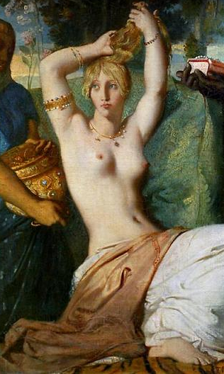
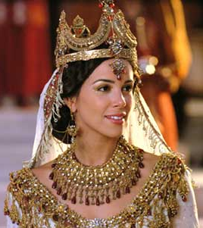
Esther—Background
Persia—beginning 483 B.C.

Slide 21
Esther—Summary
Esther chosen to be queen Esth. 1-2
Haman to exterminate Jews Esth. 3
Esther, Mordecai, & Haman Esth. 4-7
Jews take revenge Esth. 8-9
Modecai’s importance Esth. 10

Slide 22
Esther—Summary
Esther has always been a bit controversial.
Did I say that God is not mentioned in the Book of Esther?
And a Jewish young lady marries a Persian king—not exactly kosher.
And the Jews slaughter their Persian enemies at the end.
All that to make Uncle Modecai look good!

Slide 23
Esther—Summary
“Today, her story would be, a beautiful young woman living in a major city allows men to cater to her needs, undergoes lots of beauty treatment to look her best, and lands a really rich guy whom she meets on The Bachelor and wows with an amazing night in bed. She’s simply a person without any character until her own neck is on the line, and then we see her rise up to save the life of her people when she is converted to a real faith in God.” (http://pastormark.tv/2012/09/04/5-reasons-why-esther-may-be-the-toughest-bible-book-ive-ever-preached)

Slide 24
Esther—Theological Significance
Celebration of Purim
Purim in Israel!

Slide 25
Esther—Theological Significance
Providence (Esther 4:13-14)
“Tell Esther, ‘Don’t be fooled. Just because you are living inside the king’s palace doesn’t mean that you out of all of the Jews will escape the carnage. You must go before your king. If you stay silent during this time, deliverance for the Jews will come from somewhere, but you, my child, and all of your father’s family will die. And who knows? Perhaps you have been made queen for such a time as this.’”

