Slide 1
Prophets II
Nahum, Habakkuk, Zephaniah, Obadiah

Slide 2
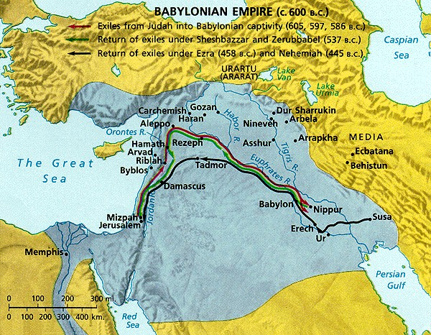
The Minor Prophets and History
Seventh Century Developments

Slide 3
Nahum
Historical Context
Destruction of Thebes, 663 (3:8)
Destruction of Nineveh, 612, imminent?
Message
Foreign prophecy against Nineveh
God is all-powerful
God created and controls the world.

Slide 4
Habakkuk
Historical Context
“Rise of the Chaldeans” (1:6)
After 612, fall of Nineveh
Before 587, destruction of Jerusalem
Message
Theodicy
Why does sin/evil go unpunished?
God’s sovereign control of the universe

Slide 5
Habakkuk 2:4
Message
The righteous “live by faith.”
"Behold, his soul is puffed up; it is not upright within him, but the righteous shall live by his faith. (Hab 2:4 ESV)
"See, he is puffed up; his desires are not upright-- but the righteous will live by his faith-- (Hab 2:4 NIV)
Habakkuk 2:4 "Look at the proud! They trust in themselves, and their lives are crooked. But the righteous will live by their faithfulness to God. (Hab 2:4 NLT)

Slide 6
Habakkuk 3:17-19
Message
Trust in God (Hab. 3)
Though the fig tree should not blossom, nor fruit be on the vines, the produce of the olive fail and the fields yield no food, the flock be cut off from the fold and there be no herd in the stalls, yet I will rejoice in the LORD; I will take joy in the God of my salvation. GOD, the Lord, is my strength; he makes my feet like the deer's; he makes me tread on my high places. To the choirmaster: with stringed instruments. (ESV)

Slide 7
Zephaniah
Historical Context
During the reign of Josiah (640-609)
Message
Yahweh will judge Judah & Jerusalem.
Yahweh will judge the nations.
A remnant of Judah will survive.

Slide 8
Obadiah
Historical Background
After 586, Edom exploited Judah
His message
God will judge Edom

